Slide 1
Onsite Data and Model Simulations for Continuous Building Commissioning
ENERGIFORUM 21LIVE
Muhyiddine Jradi
Associate Professor, SDU Center for Energy Informatics
mjr@mmmi.sdu.dk
9 March 2021

Slide 2
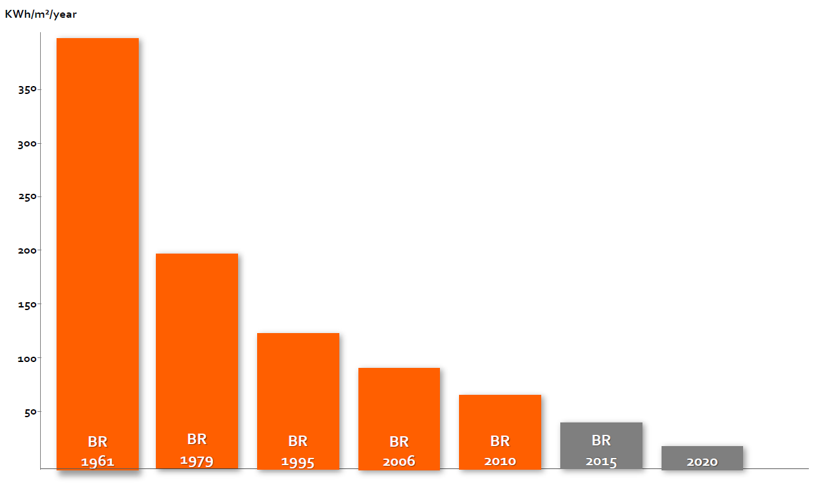
Background

Slide 3
Energy Performance Gap
We can’t take the building performance for granted!

Slide 4
What is Building Commissioning?
ASHRAE Definition: Commissioning is the process of ensuring that systems are designed, installed, functionally tested, and capable of being operated and maintained to perform in conformity with the design intent.

Slide 5
Commissioning Cost-Savings
8% - 20% reduction in operating costs
1.5 - 5.5 year simple payback on commissioning.
Top 10 priority faults in the US small-commercial buildings in 2017 resulted in around 52750 GWh energy losses and substantial $7 billion in operational cost (Kim et al., 2018).

Slide 6
Continuous Commissioning
There is an urgent need for a systematic and automated continuous commissioning process that runs throughout the building operational phase:
Aid in verifying if the energy performance indicators are met
Help in developing and implementing operational strategies
Form a basis for a effective fault detection and diagnostics

Slide 7
BuildCOM Project
Partners

Slide 8
BuildCOM Project
This BuildCOM project will advance the state-of-the-art through the development and demonstration of an innovative set of tools for BMS automated auditing and continuous building commissioning.
This first-of-its kind set of tools with three major capabilities and features:
1. Initial commissioning of BMS
2. Retro-commissioning of BMS
3. Continuous building commissioning

Slide 9
ObepME: Online Building Energy Performance Monitoring and Evaluation Tool

Slide 10
Online Performance Monitoring

Slide 11
Online Performance Monitoring
Develop an overall dynamic energy model in EnergyPlus to predict the energy performance of the building.
Simulate the building’s expected behavior, given
Data from weather station
Occupancy data
Set Points and building operation data
A dashboard is developed to continuously compare predictions with the actual performance data from meters.

Slide 12
OU44 Building - SDU
Heated Area | 8468 m²
Stories | 3 + 1 (basement)
Building year | 2015
Energy class | BR2020 (BE10)
Design energy consumption | ≈ 41.3 kWh / (m² year)
Heating type | District heating
Use | Teaching rooms, meeting rooms, offices
Available data | Architectural design Building services documentation BMS specifications, Data logs

Slide 13
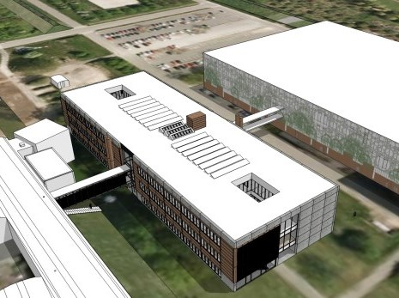
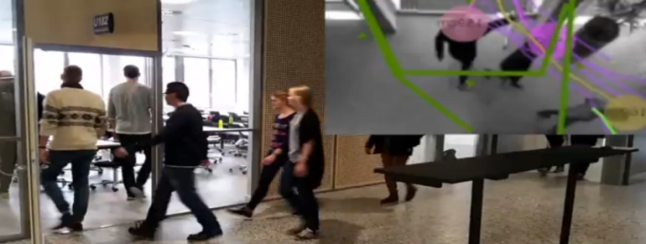
OU44 Building - SDU
Sensors / Meters:
Electricity meters (64)
Heat meters (12)
Water meters (4)
Occupancy counters (17)
CO2 (per room)
Illuminance (per room)
Temperature (per room)
Humidity (per room)
PIR (per room)
Ventilation system (valves, temperatures)
Heating system (valves, temperatures)
Cameras across all entrances and floors
Occupancy counter camera
Real-time occupancy counters

Slide 14
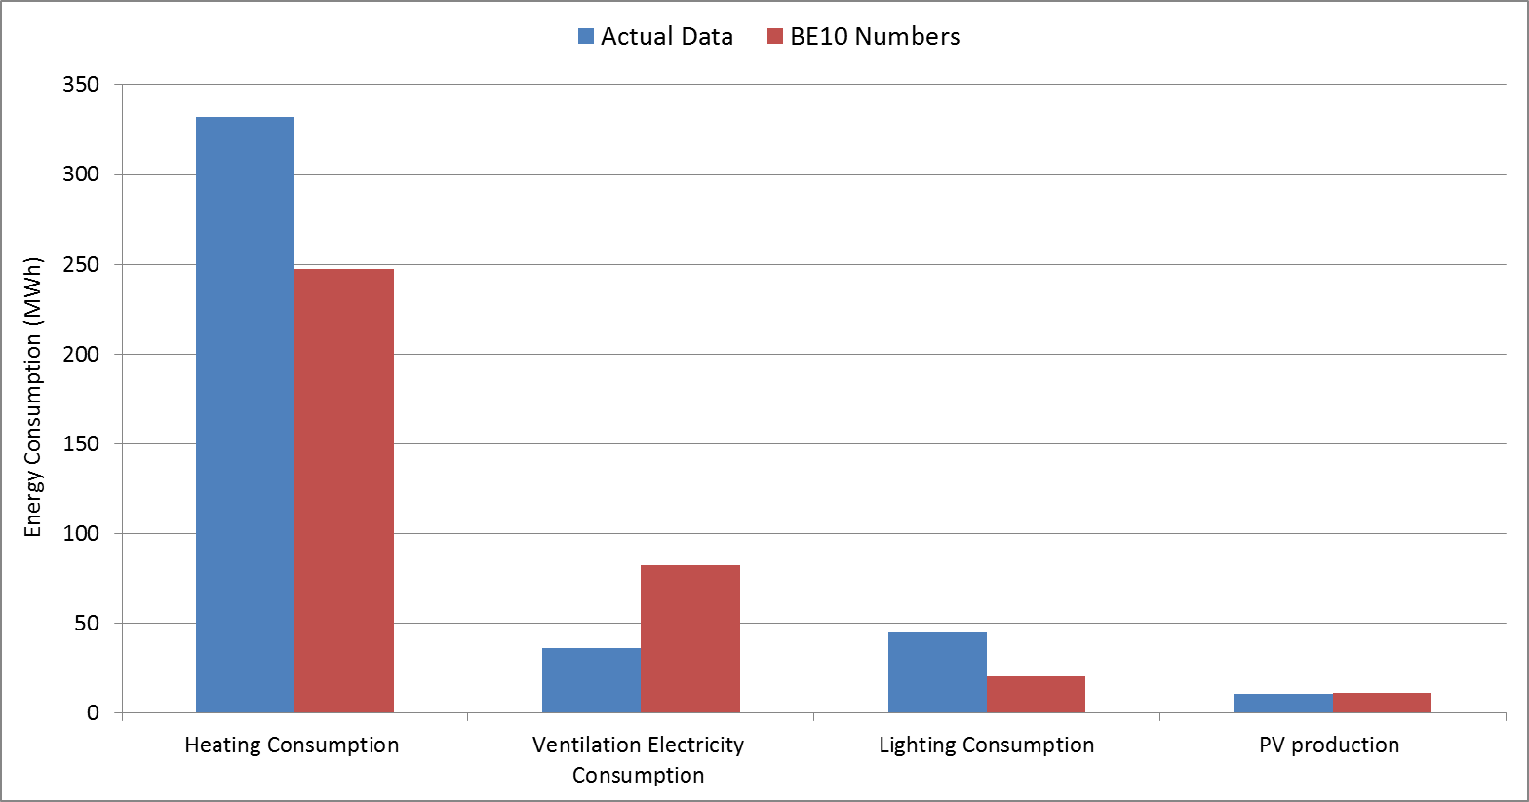
OU44 Building - SDU
Energy Performance: Actual vs Design (BE10)
Building Energy Consumption, Actual vs BE10

Slide 15
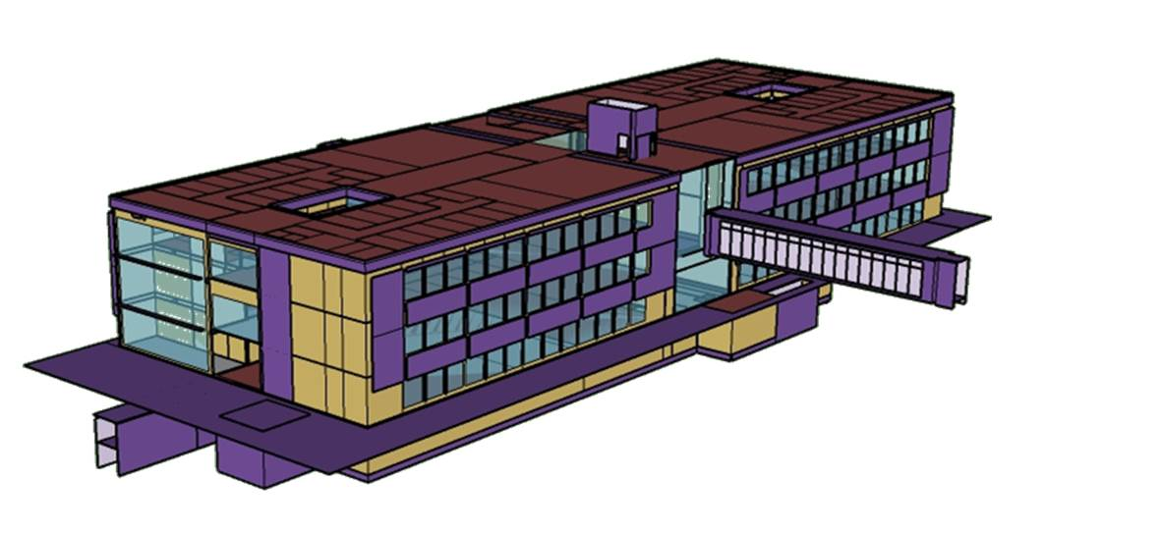
OU44 Energy Model
A Detailed dynamic model was developed in EnergyPlus comprising:
3 building floors and a basement
190 thermal zones
4 ventilation air loops with heat recovery units
District heating loop
Actual building materials and constructions
Various schedules and operation set points
OU44 Sketchup Model

Slide 16
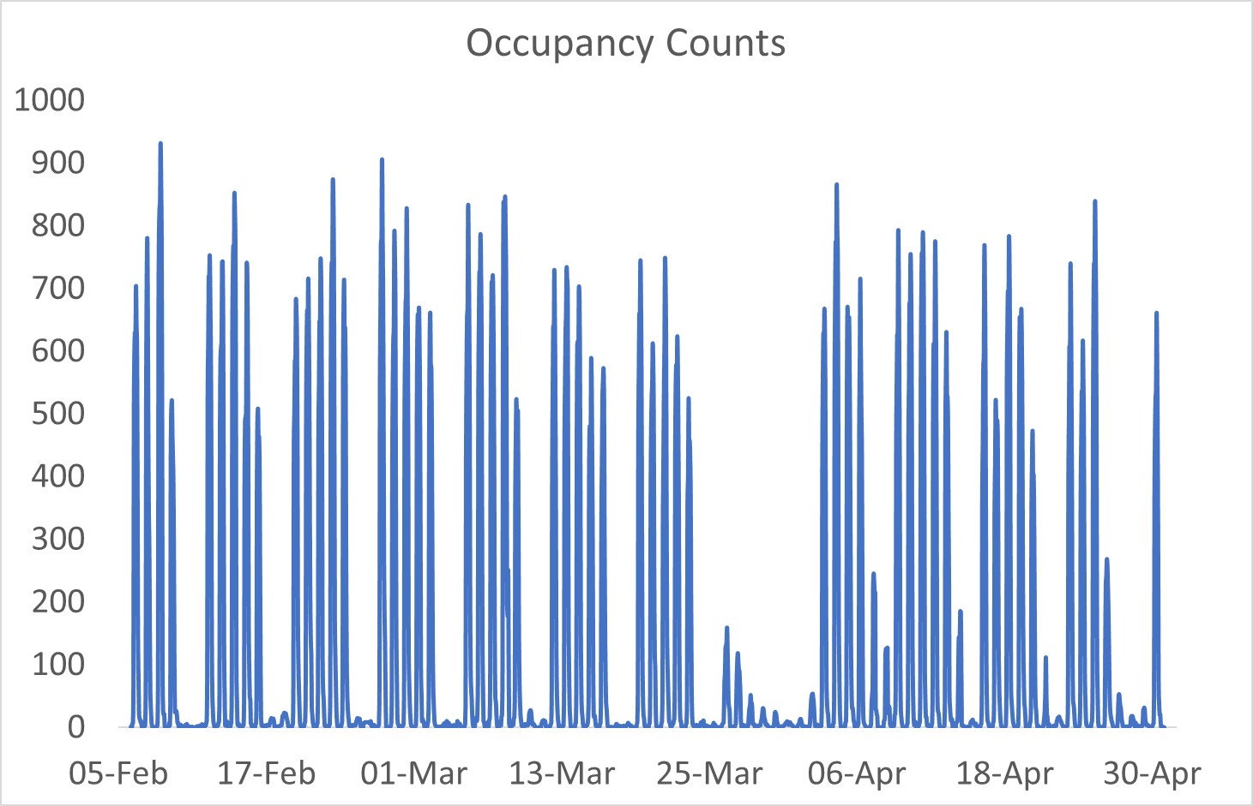
OU44 Energy Model
The model was calibrated using:
Actual data on energy consumption
Occupancy counts from cameras all around the building
Updated schedules and operation set-points
Real Weather conditions

Slide 17
Building Energy Performance
Building Energy Performance Dashboard

Slide 18
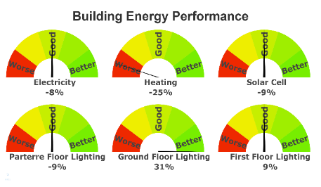
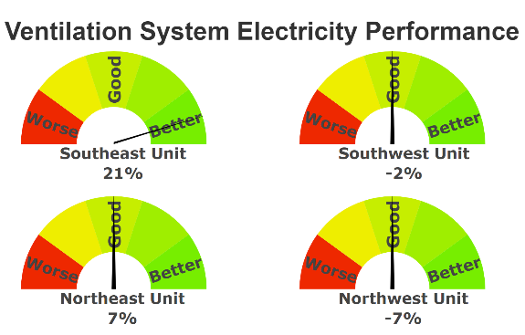
Building Energy Performance
ObepME Evaluation Results for the first two weeks in May:

Slide 19
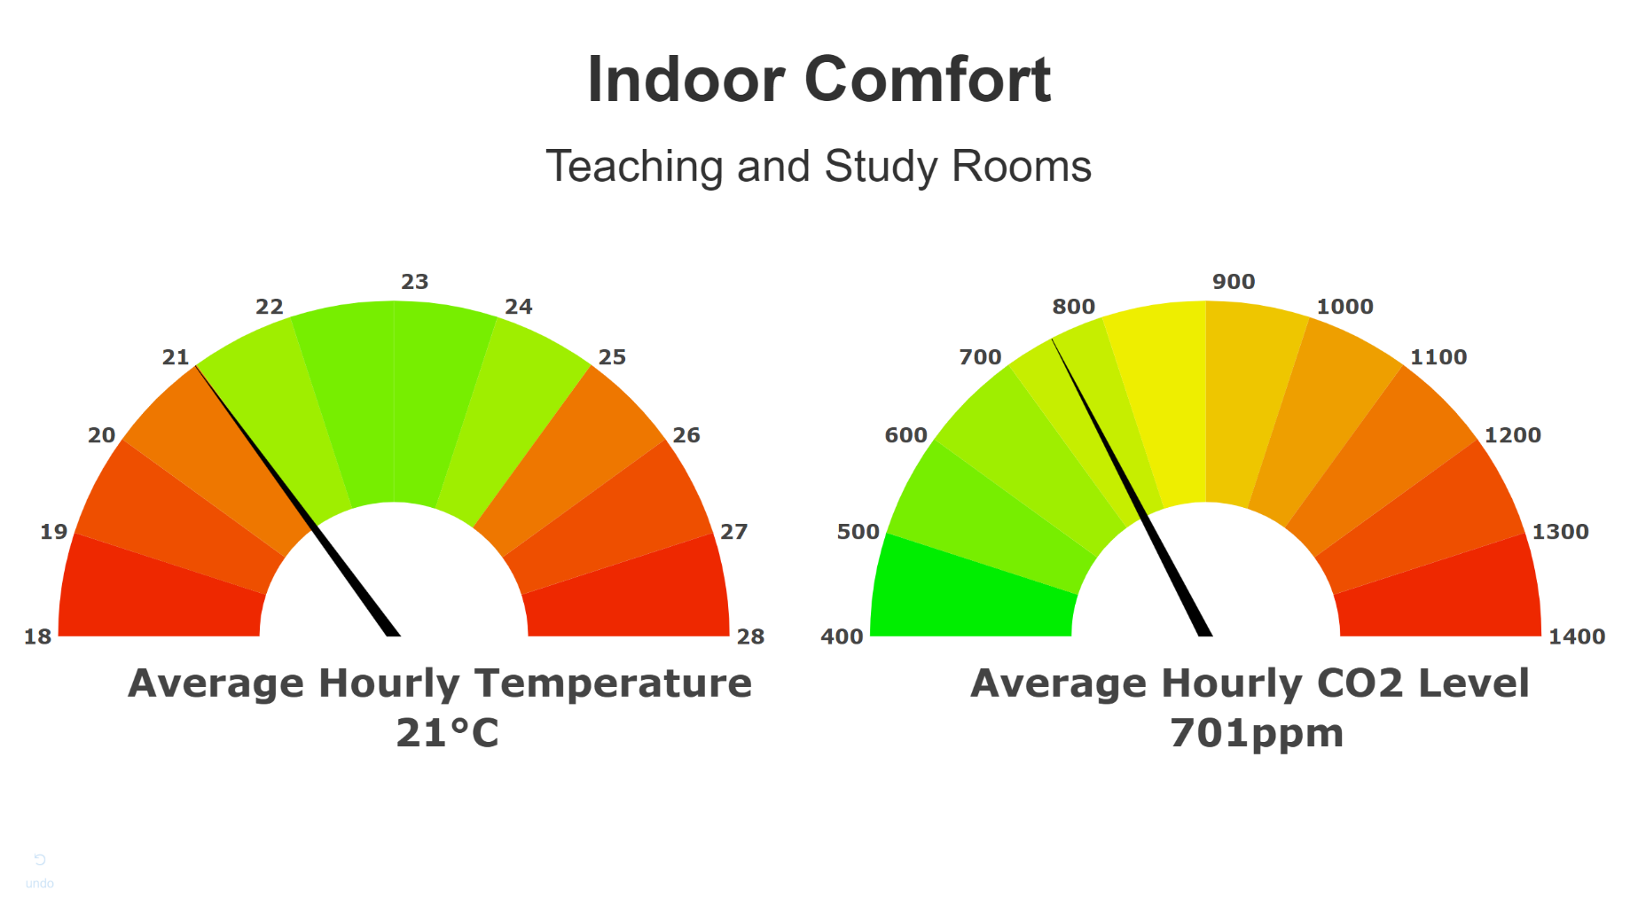
Building Energy Performance

Slide 20
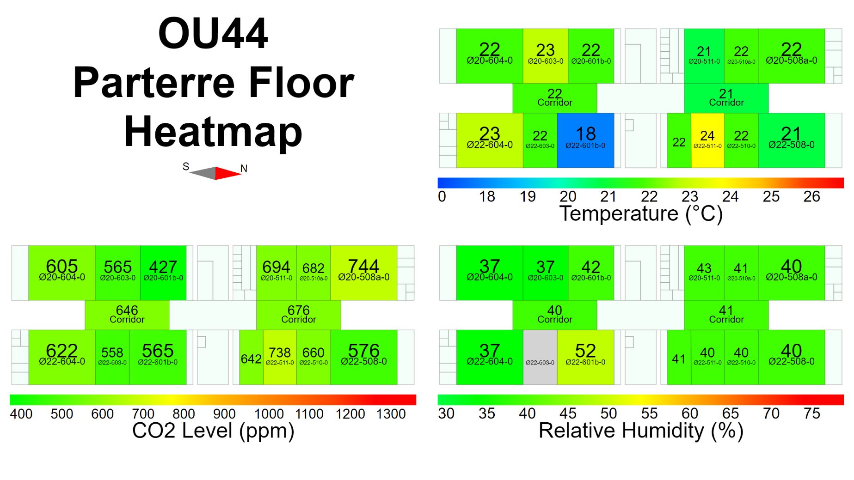
Building Energy Performance

Slide 21
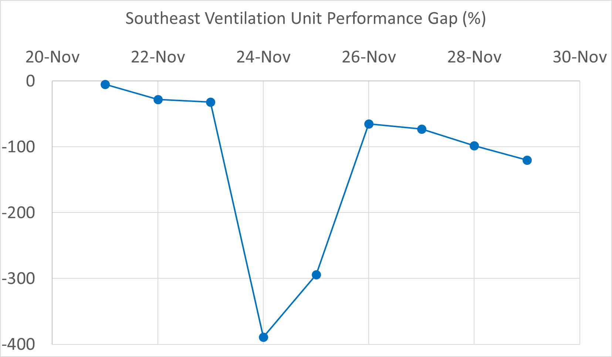
Ventilation Unit Mal-function
Mal-Functioning Ventilation Unit Reported:

Slide 22
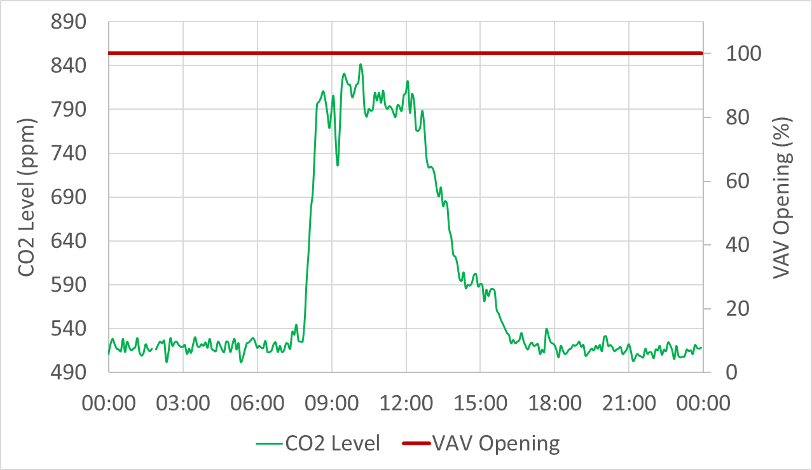
Ventilation Unit Mal-function
One of the air diffusers in a large teaching room (U181) on the first floor, has a reported damper position of 100% (totally open), for most of the period from 21 to 29 November.
An example of 29 Nov. is shown in the Figure where CO2 level didn’t exceed 900 ppm for the majority of the day, where the VAV damper was fully open all day.

Slide 23
Ventilation Unit Mal-function
A problem with the VAV diffuser controller was identified.
The average monthly avoidable operational costs due to eliminating this problem is around 2700 DKK.

Slide 24
Buildings In Line
Bornholm Hospital Building
OUH Odense Building

Slide 25
Thank You ☺

