Slide 1
Balancing Accuracy and Cost of IoT Technology
Mikkel Baun Kjærgaard, Professor, Mærsk Mc-Kinney Møller Institute, SDU
Henrik Dyrberg Egemose, PhD Student, Mærsk Mc-Kinney Møller Institute, SDU
Mads Hundevad Jensen, Software Developer, Mærsk Mc-Kinney Møller Institute, SDU

Slide 2
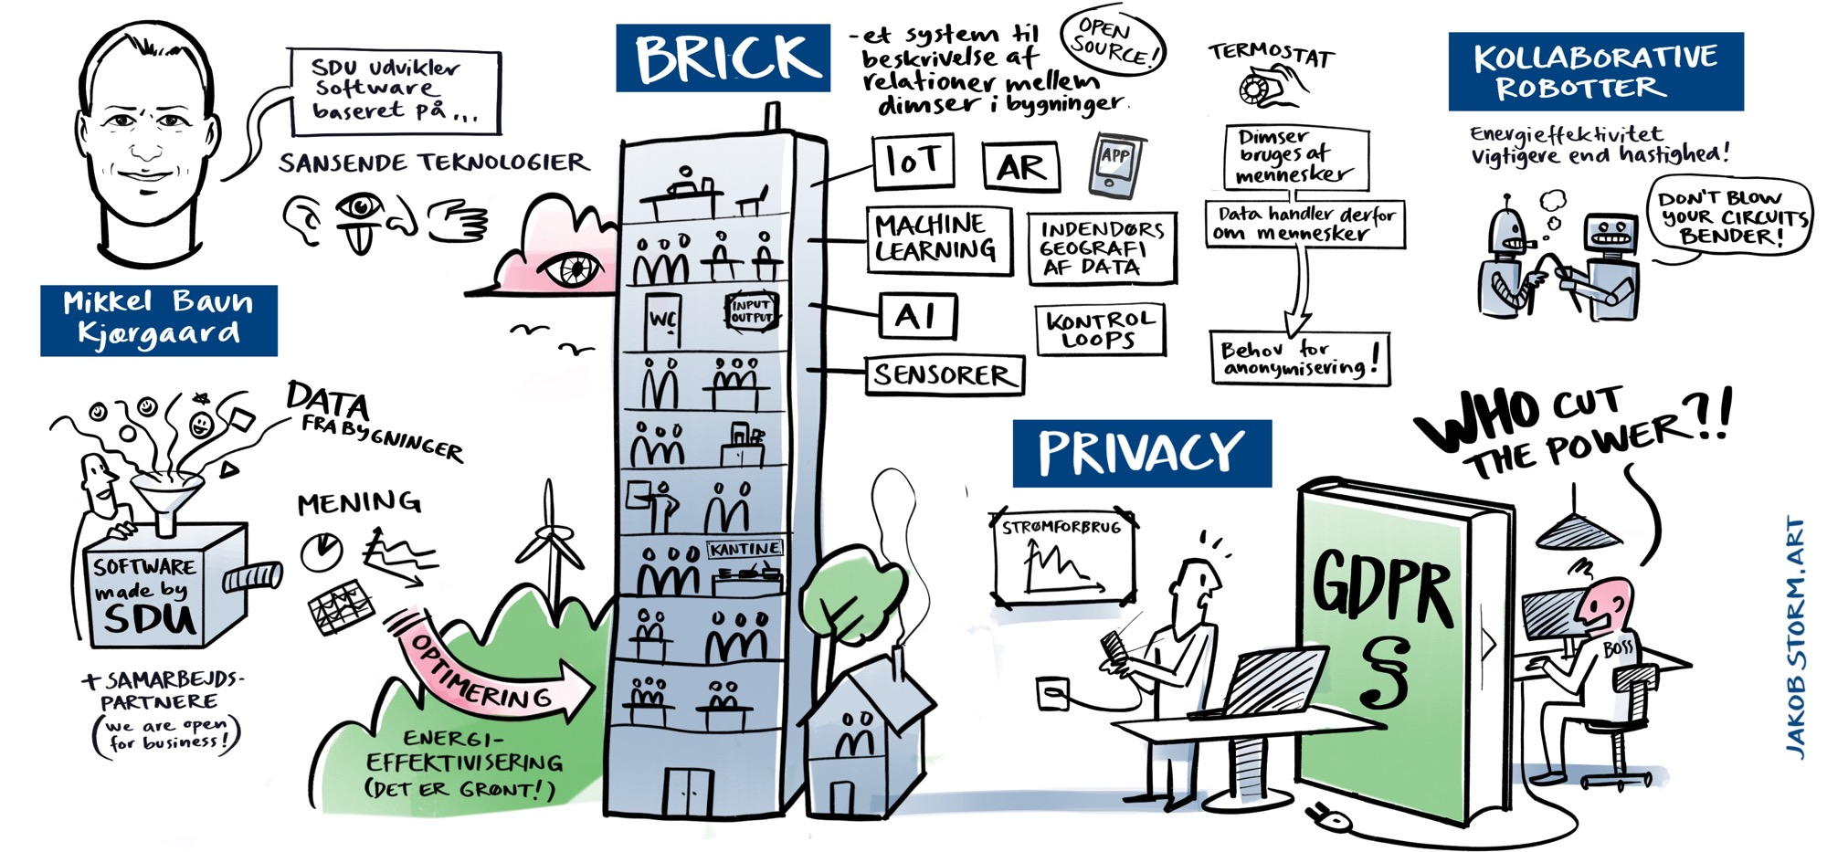

Slide 3
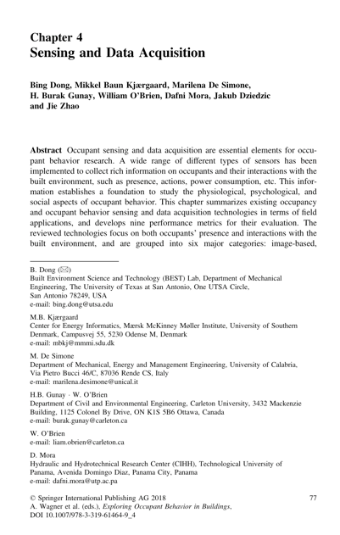
Tradeoff between sensor modality, cost and accuracy

Slide 4
Case from Data-driven Expert Project
Calculate a set of energy KPIs for buildings based on IoT data that:
  Are simple to understand
  Consider presence of building occupants with higher accuracy than common approaches of energy consultants based on guesstimates
  Calculates estimates for the presence of building occupants from any coverage of IoT data to be cost-effective
  Assumes minimal information about buildings

Slide 5
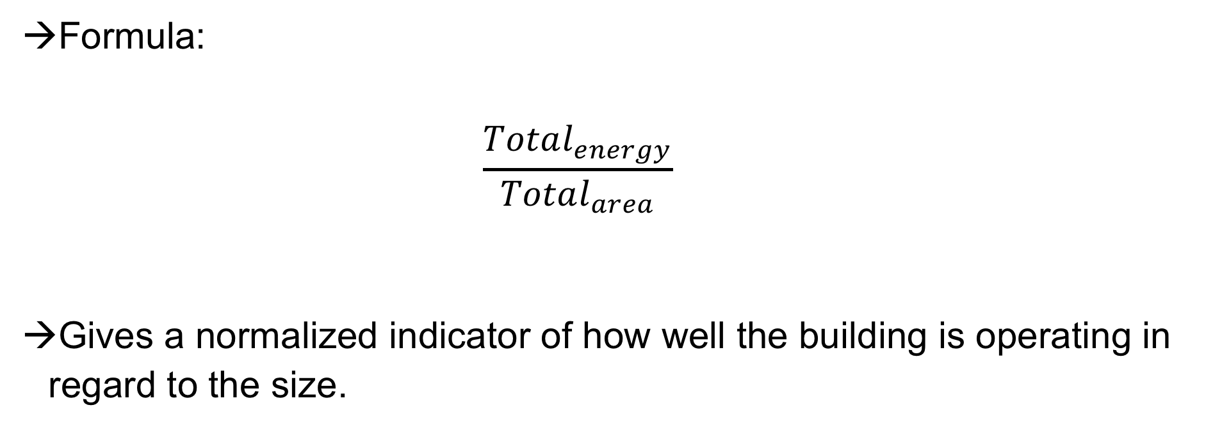
Traditional KPIs are based on Area Normalized Use
Formula:
  $$\frac{Total_{energy}}{Total_{area}}$$
Gives a normalized indicator of how well the building is operating in regard to the size.

Slide 6
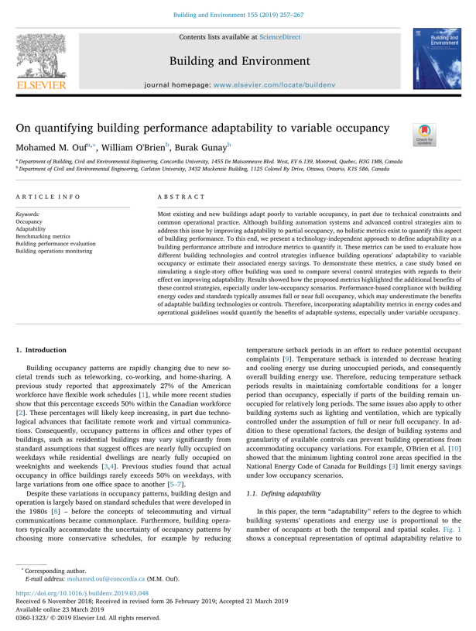
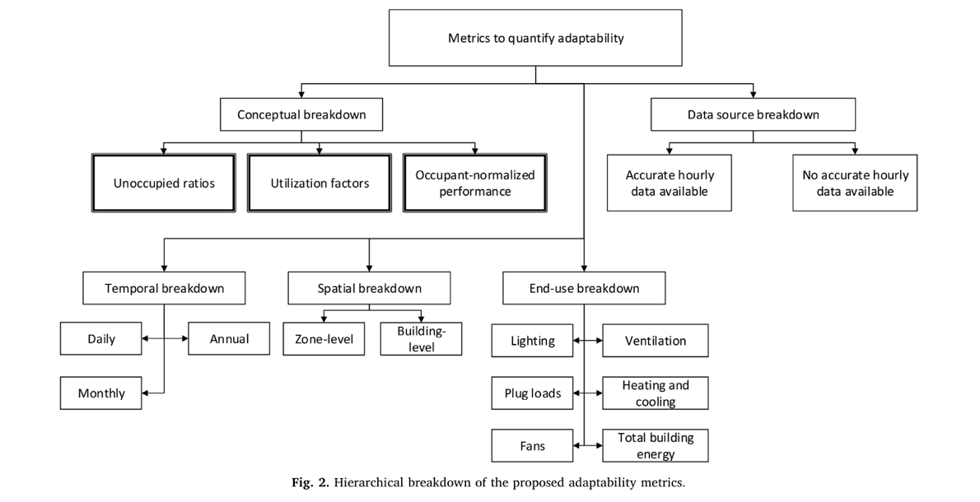
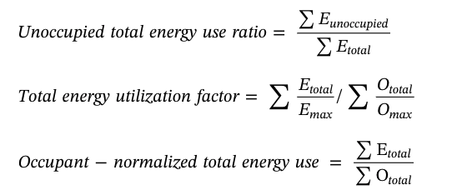
Occupant Adaptability KPIs

Slide 7

Occupant Normalized Energy Consumption
Formula:
  $$\frac{Total_{energy}}{Total_{occupancy}}$$
The total energy data can be for: Light, Plug, Fan, Heating, Cooling, Whole building
Occupancy total can be calculated from IoT data by statistical methods. Simplest option is to use data from motion and CO₂ sensors

Slide 8




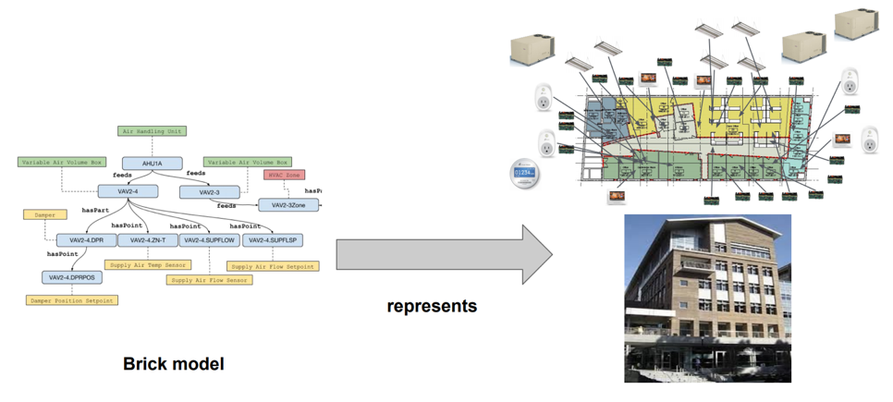
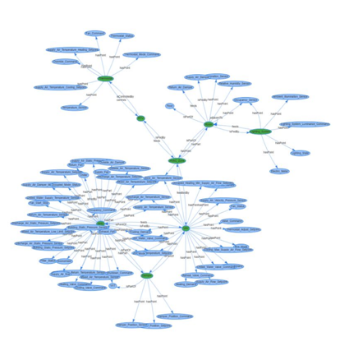




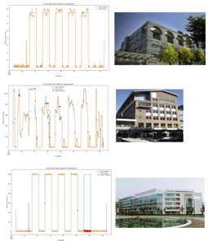
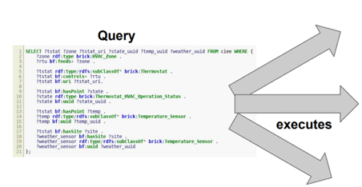
Data Modeling via Brick
Getting started: https://brickschema.org/

Slide 9
Example Building
Office
Office
Office
Hallway
Motion and CO₂ sensor =
Ventilation (kWh) =
Building information
Area = 175 m2
Average room size = 25 m2
Max capacity = 28 persons
Occupants per room = 4 persons
Office
Office
Office

Slide 10
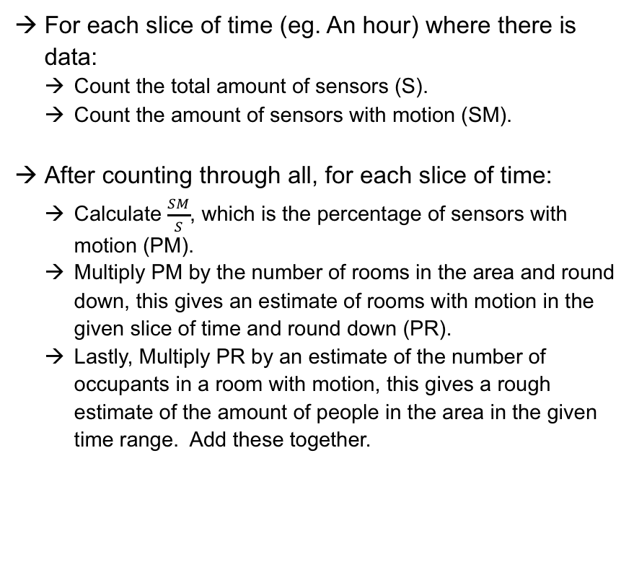
Calculate Occupancy
For each slice of time (eg. An hour) where there is data:
  Count the total amount of sensors (S).
  Count the amount of sensors with motion (SM).
After counting through all, for each slice of time:
  Calculate $\frac{SM}{S}$, which is the percentage of sensors with motion (PM).
  Multiply PM by the number of rooms in the area and round down, this gives an estimate of rooms with motion in the given slice of time and round down (PR).
  Lastly, Multiply PR by an estimate of the number of occupants in a room with motion, this gives a rough estimate of the amount of people in the area in the given time range. Add these together.
Building numbers
  Number of rooms: 7
  Occupants on motion (Assumption): 4
 | Sensor 1 | Sensor 2 | Sensor 3 | Sensors | Motion Count | PM | PR | Occupants
Hour 1 | 0 | 1 | 1 | 3 | 2 | 0.66 | 4 | 16
Hour 2 | 1 | 1 | 1 | 3 | 3 | 1.0 | 7 | 28
Hour 3 | 1 | 1 | 0 | 3 | 2 | 0.66 | 4 | 16
Hour 4 | 1 | 0 | 0 | 3 | 1 | 0.33 | 2 | 8
Hour 5 | 0 | 0 | 0 | 3 | 0 | 0.0 | 0 | 0
Total |  |  |  |  |  |  |  | 68

Slide 11
Calculate KPI
Simply sum up data for the given zone within the given time range.
Example (Ventilation):
  If you have 1 sensors in a zone, with data for every hour, for 5 hours.
  Simply add all data for all 5 hours.
Occupancy normalized consumption is
13/68 = 0,19 kW per occupant
 | Occupants | Ventilation (kWh)
Hour 1 | 16 | 2
Hour 2 | 28 | 3
Hour 3 | 16 | 4
Hour 4 | 8 | 2
Hour 5 | 0 | 2
Total | 68 | 13

Slide 12
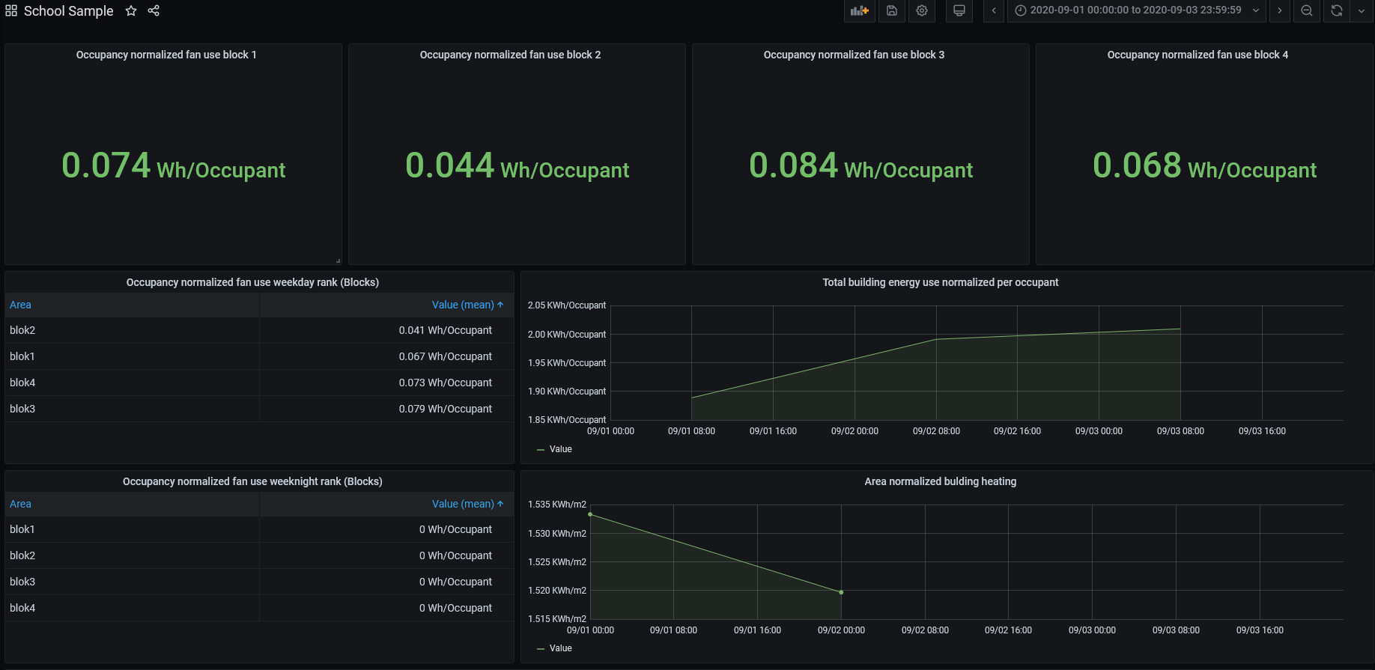

DDE Dashboard Example
IoT Sensors & Infrastructure
Vitani
Data Platform
DDE – KPI calculator
DDE – Grafana Data Source

Slide 13
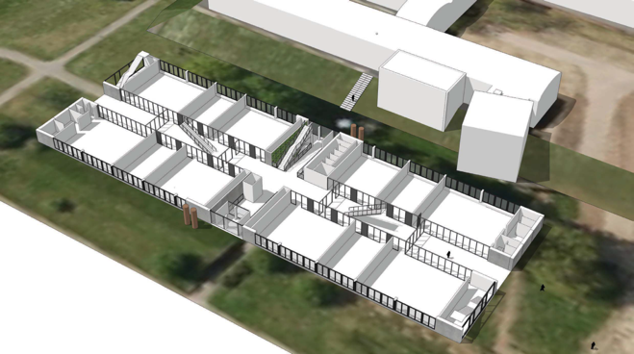

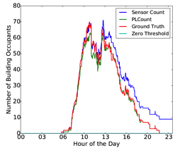
Case Study with SDU OU44 data
3D stereovision cameras
30 days from September to October 2016 which are busy months in the building.
The dataset contains:
345,600 people counts
3,499,200 motion sensor readings 3,844,000 CO₂ readings
Fisayo Caleb Sangoboye, Mikkel Baun Kjærgaard: PLCount: A Probabilistic Fusion Algorithm for Accurately Estimating Occupancy from 3D Camera Counts. BuildSys@SenSys 2016: 147-156

Slide 14
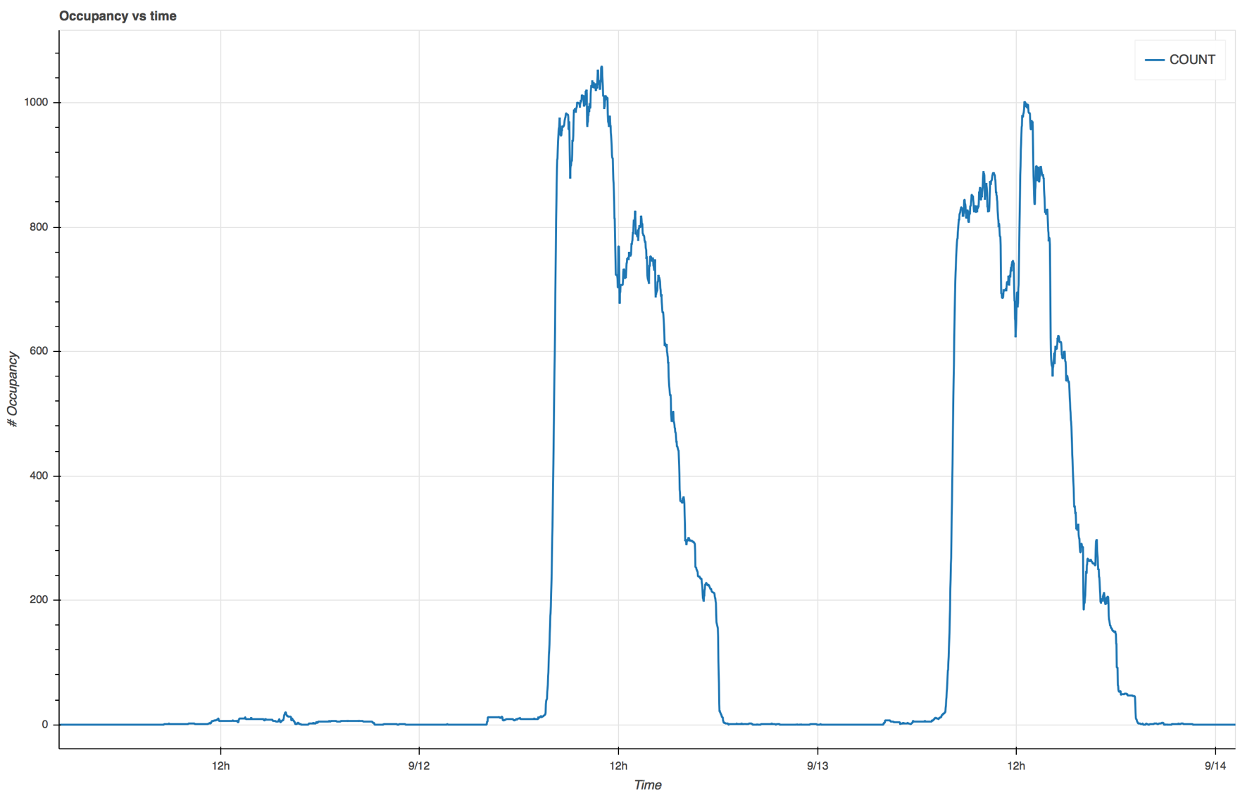
Sunday
Monday
Tuesday

Slide 15
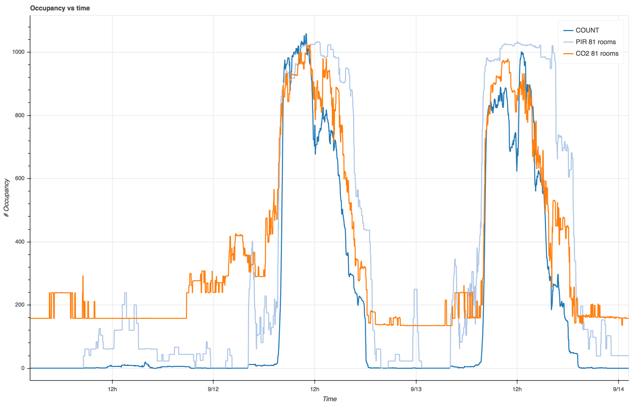

Slide 16
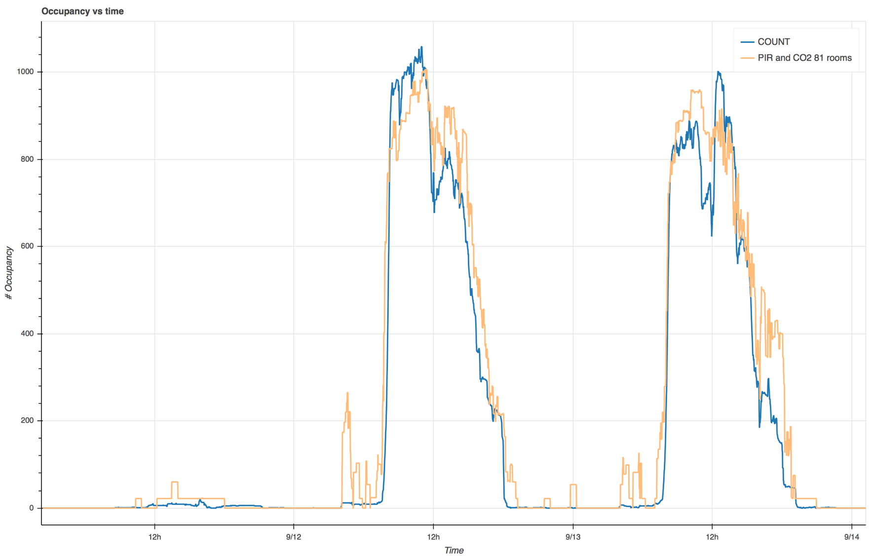

Slide 17
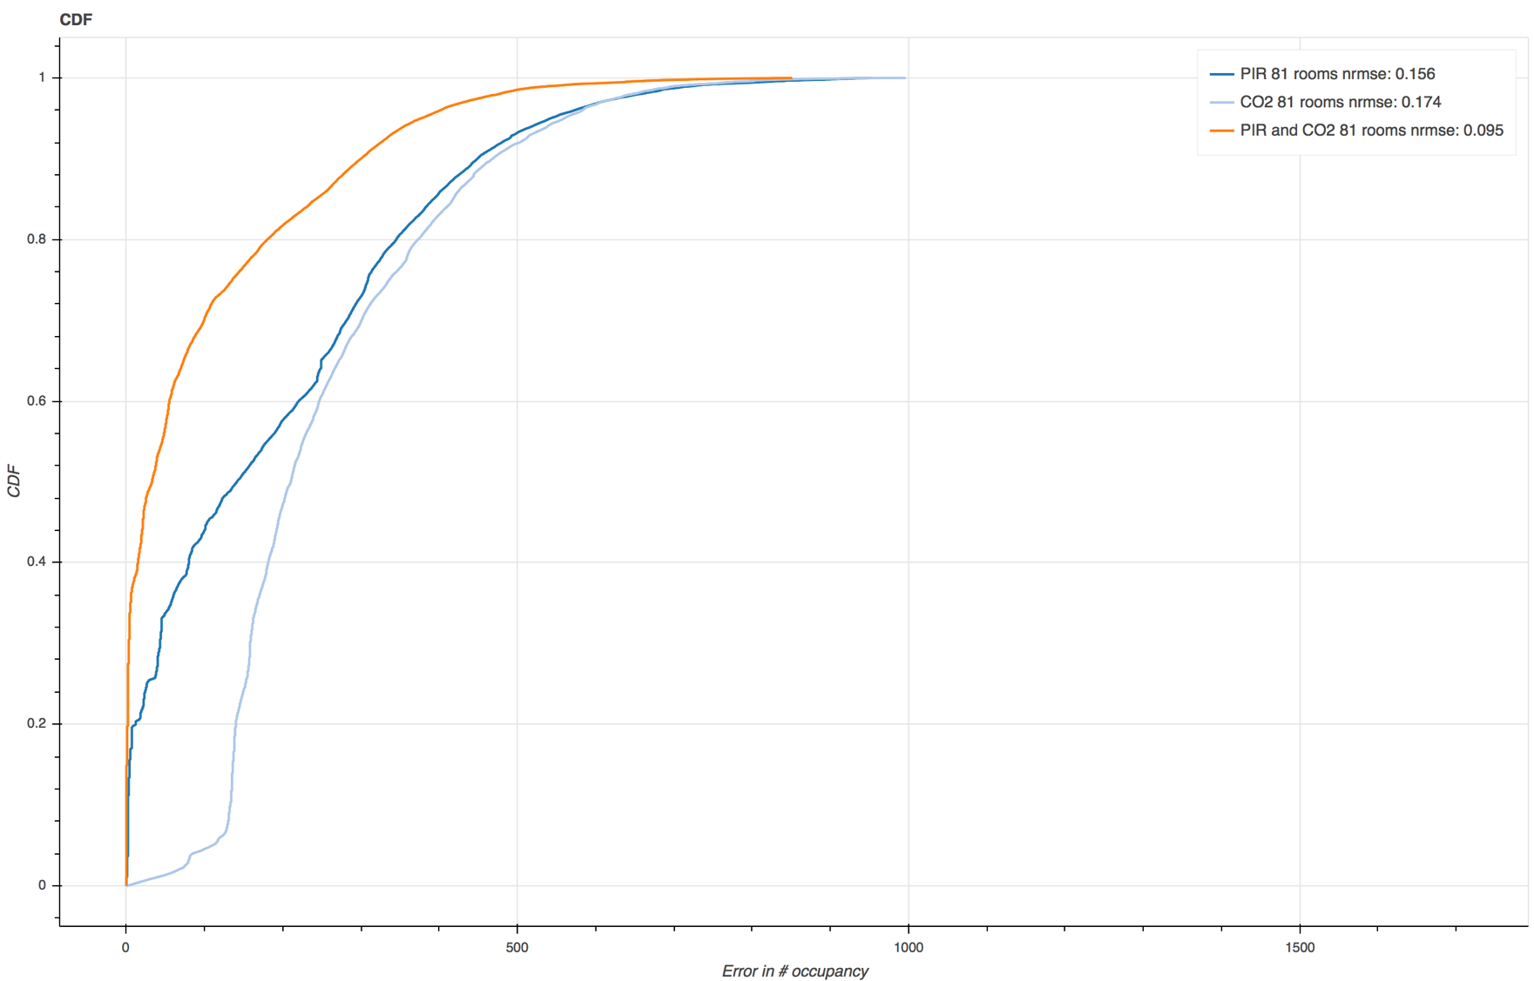

Slide 18
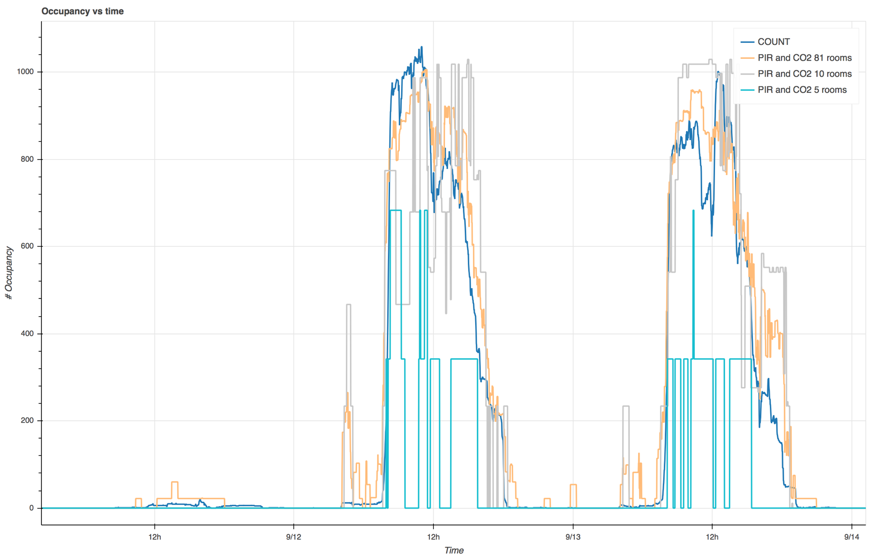

Slide 19
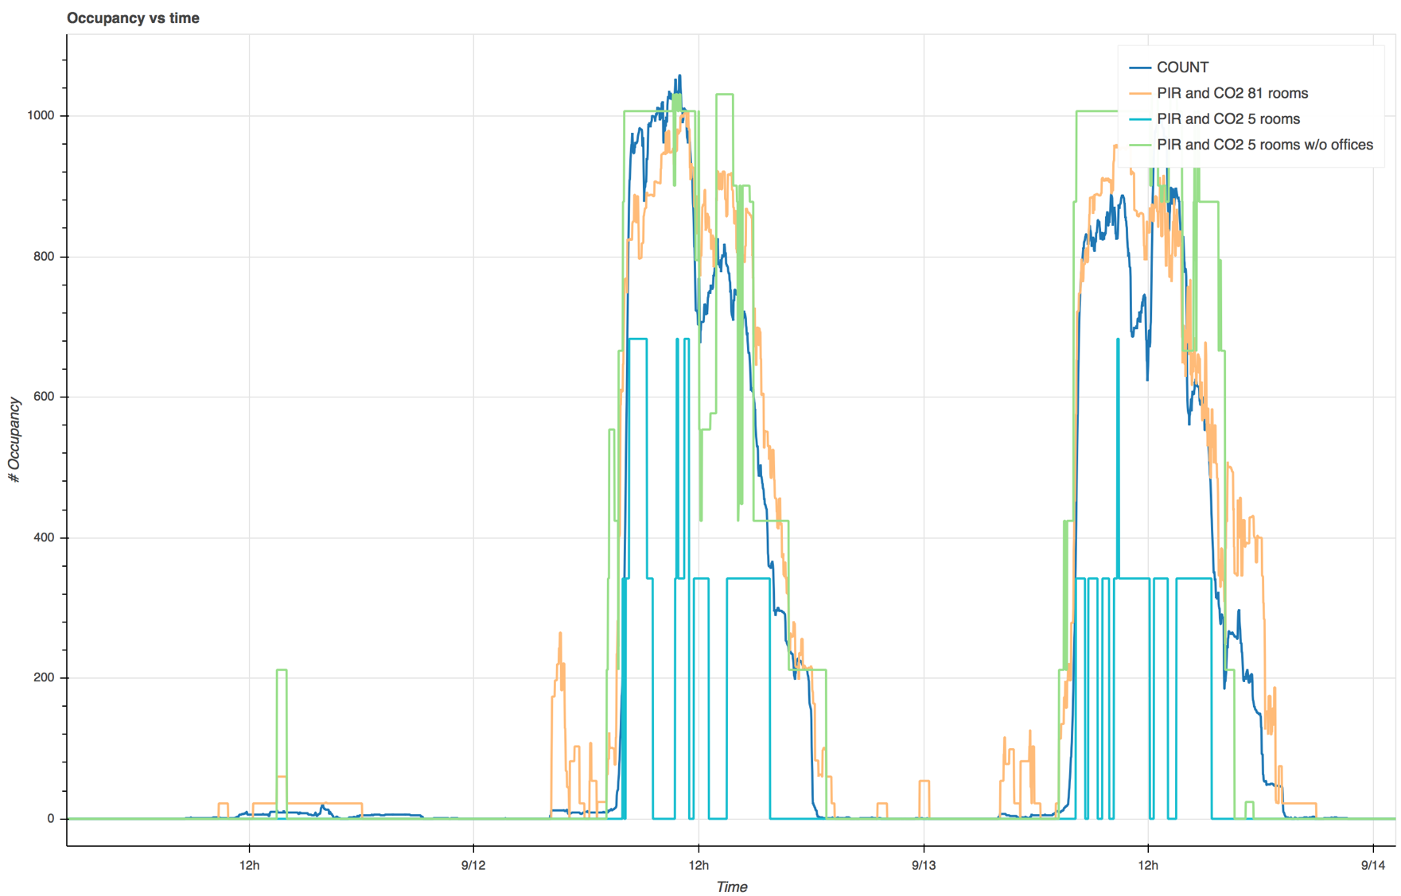

Slide 20
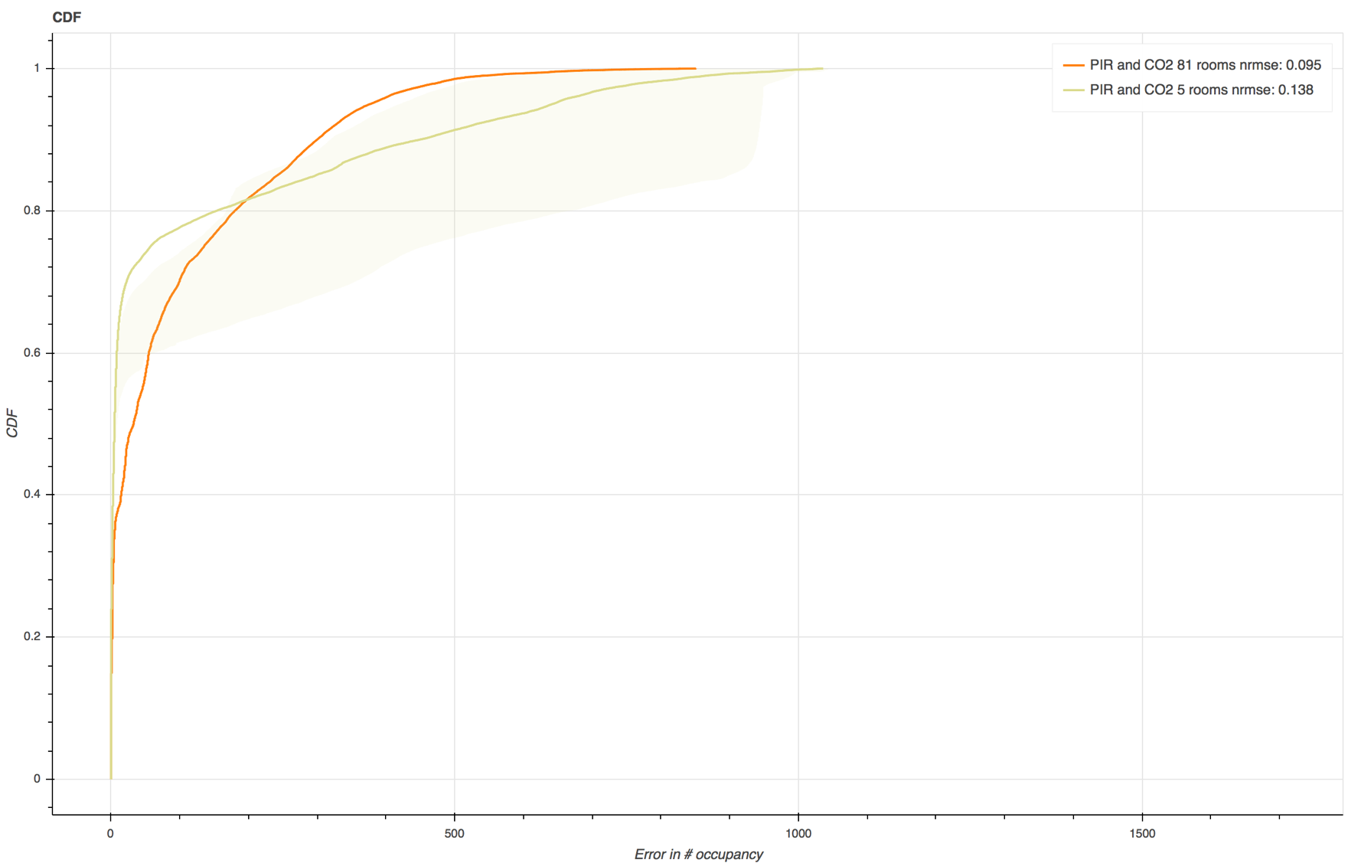

Slide 21
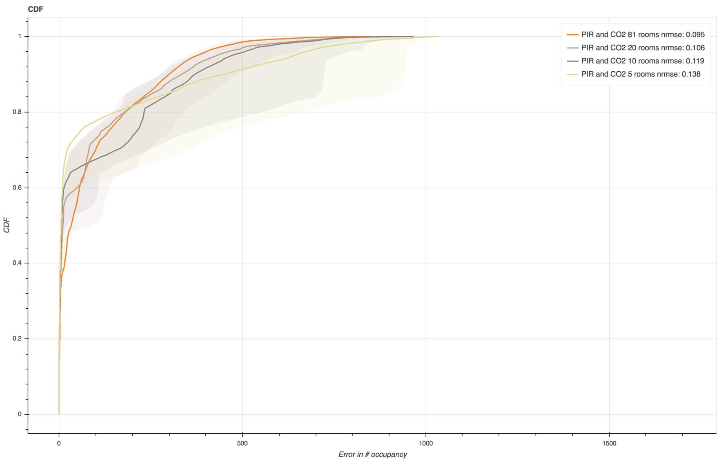

Slide 22
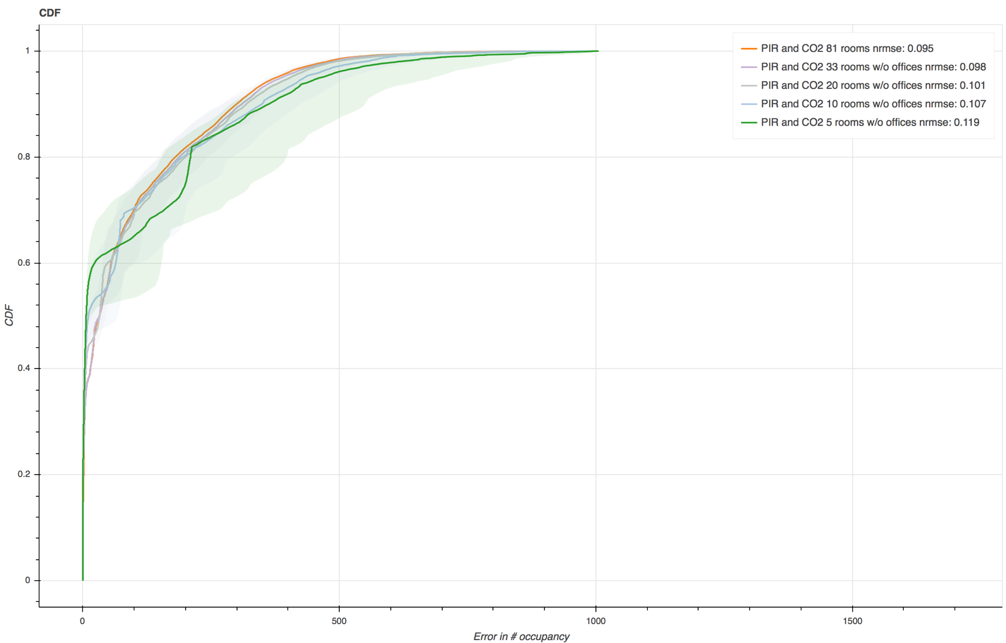

Slide 23
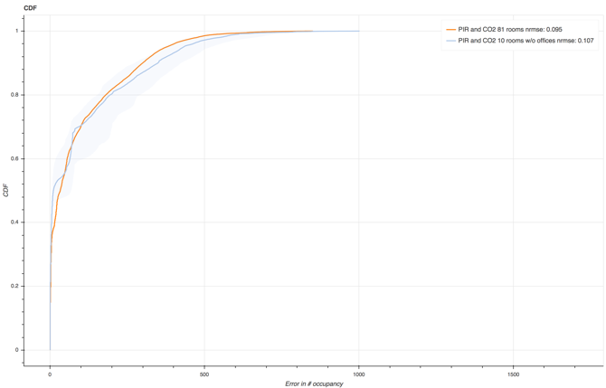
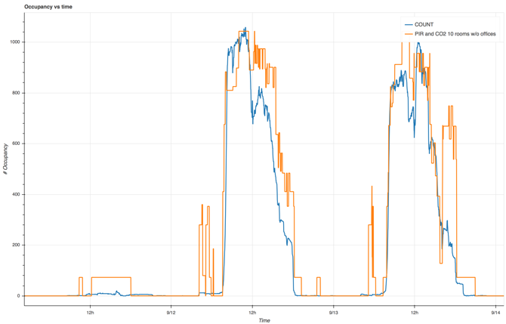
Case Study Conclusions
When placing sensors to subsample presence this case study suggest to:
  Select the largest rooms with the most predictable and representative presence characteristics
  Only covering 12% of the rooms gives a very small accuracy drop compared to sampling in all rooms.

