Slide 1

CO₂ fangst og lagring
Principper, teknik og potentiale
Center for Energy Resources Engineering (CERE)
Department of Chemical Engineering
Technical University of Denmark (DTU)
Philip Loldrup Fosbøl
Supported by many innovative colleagues

Slide 2
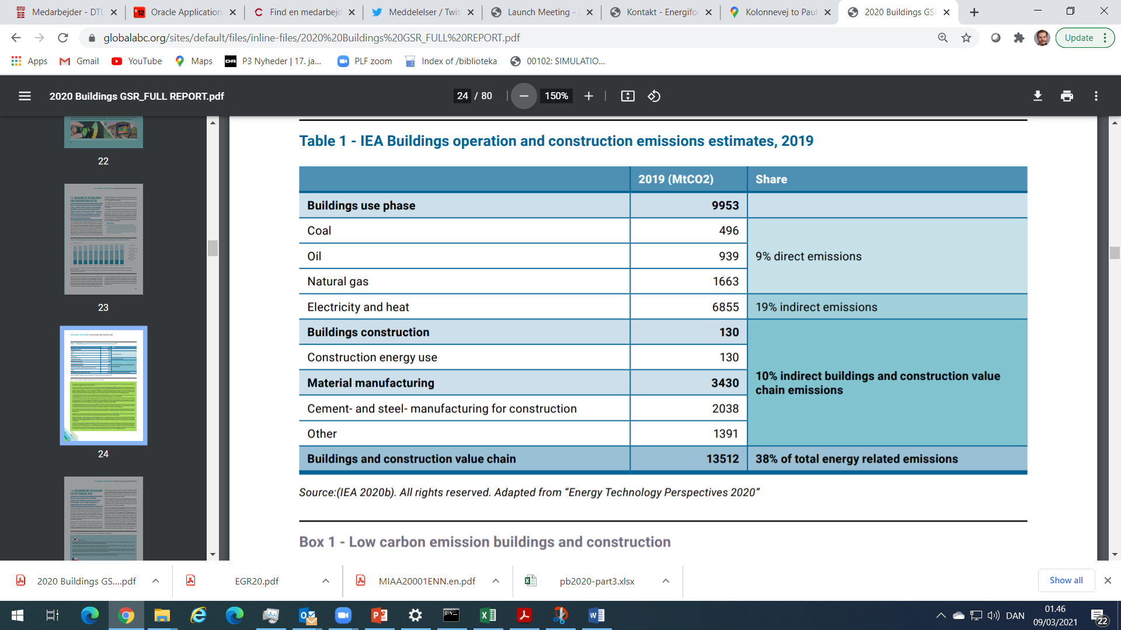
Emissions from buildings
World:
  Total GHG: 50 GT
  Total CO₂: 37 GT
Buildings:
  14 GT
  Construction: 0.1 GT
CO₂ Source:
  Materials + power/heat
of 37 GT
Source: UNEP, 2020
Notes:
UNEP emission from building and construction 2020, right figure, only CO2 not GHG total 37GT

Slide 3
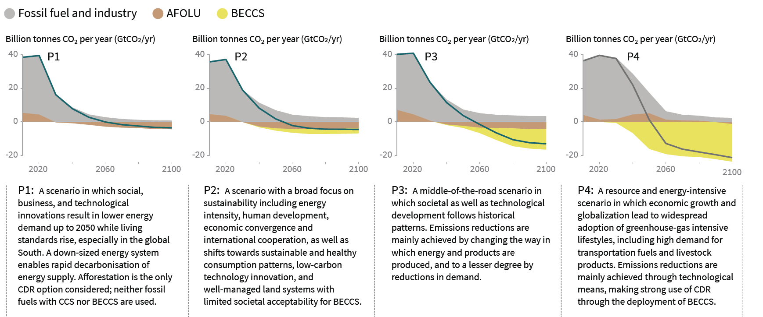
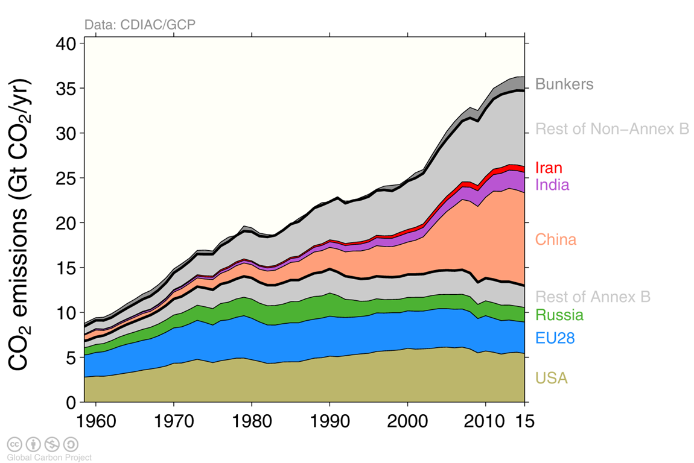
Future: Negative CO₂ emissions
Source: IPPC, https://report.ipcc.ch/sr15/pdf/sr15_spm_final.pdf, side 19
Notes:
http://www.globalcarbonproject.org/carbonbudget/17/presentation.htm

Slide 4
Current CO₂ utilization
35 Gton CO₂
0.3 Gton CO₂
Emissions
Utilization (1%)
Source: E. Alper, O. Yuksel Orhan / Petroleum 3 (2017) 109

Slide 5
Challenges in the future
35 Gton CO₂
3 Gton CO₂
Current utilization (0.3 Gton)+
Synthetic fuel (1 Gton) +
All plastic (1 Gton) +
Other (0.7 Gton)
Emissions
Source: PlasticEurope, 2015
Notes:
https://committee.iso.org/files/live/sites/tc61/files/The%20Plastic%20Industry%20Berlin%20Aug%202016%20-%20Copy.pdf

Slide 6
Future challenges – negative emissions
35 Gton CO₂
IPCC negative
22 Gton
Emissions
Climate goal
We must remove CO₂ from the atmosphere
Utillization is OK, but we must do it even better

Slide 7

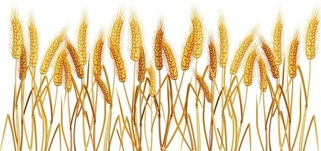

CO₂ utilization (CCU(S))
CO₂
CO₂
Substitution of
fossil fuel
Energy storage
CO₂
CO₂
biomass/
waste
CO₂
CO₂
H₂
CO₂

Slide 8
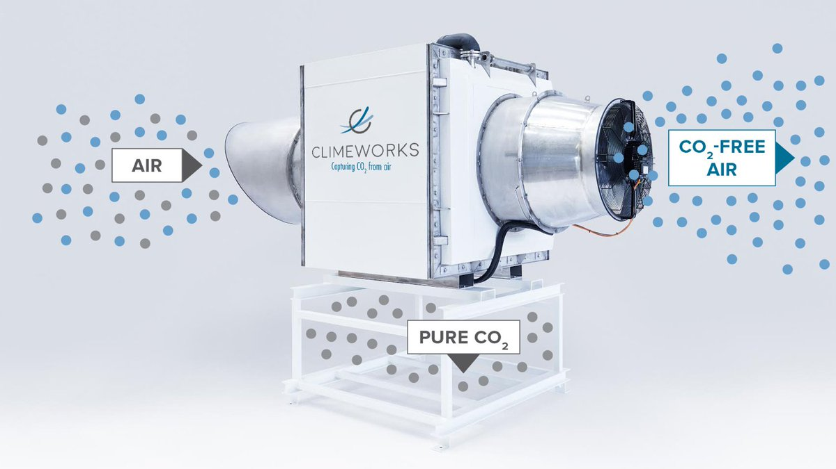
CCS/BECCS/DAC: CO₂ capture and storage – Negative emission
CO₂
CO₂
CO₂
BECCS
(Bio-Energy with Carbon Capture & Storage)
CO₂
biomass/
waste
CO₂
CO₂
2.5 km
CO₂
CO₂
CO₂
CO₂
CO₂
CO₂

Slide 9
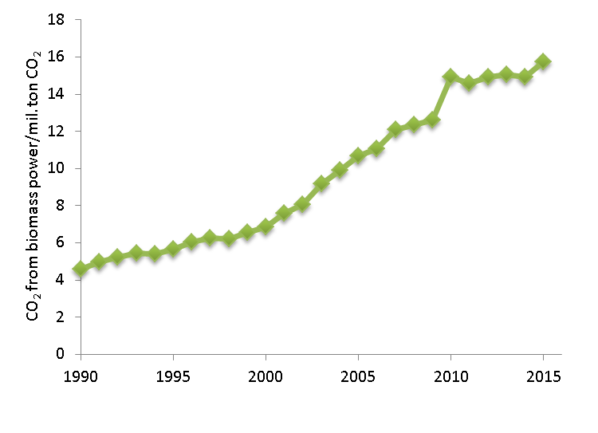
Negative emissions is not obtained by CO₂ conversion or using CCS on fossil fuel
Negative emissions are only obtained by storing green CO₂
CO₂ removal from biomass power
CO₂ removal from Biogas
CO₂ removal from green waste combustion
Direct Air Capture (DAC)
DK emissions: 52.4 MTCO2eq
Farming: 10.3 MTCO2eq
Cement: 1.0 MTCO2eq
Notes:
https://dce2.au.dk/pub/SR231.pdf
https://cdr.eionet.europa.eu/dk/Air_Emission_Inventories/Submission_UNFCCC/

Slide 10
CO₂ capture
Clean gas
Pure
CO₂
Advantage: very high TRL
Challenge: noticeable energy use
Absorber
HE
Desorber
Industrial gas
Industrial
gas
CO₂
Capture Solvent
Reboil

Slide 11
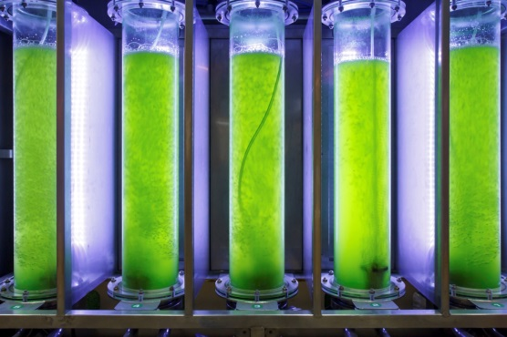
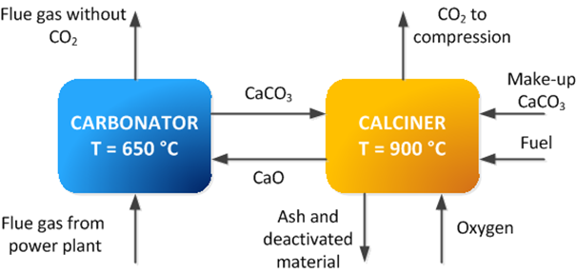
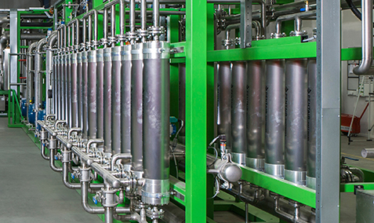
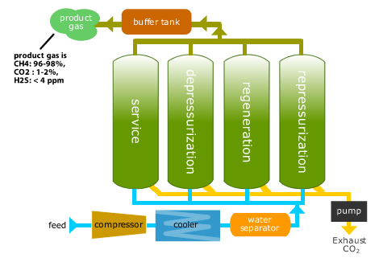
Gas separation technologies being applied
Solvent based capture (single phase, VSLE, VLLE)
  Amines
  Ammonia
  Ionic liquids
  Amino acids
  Alkali (Potassium Carbonate)
  Promoters
  Enzymes (carbonic anhydradrases)
  Physical sorbent
Carbon/calcium looping
Membranes (ceramic and polymers)
Hydrates
Algae
Zeolites (adsorption)
Cryogenic freeze precipitation
Electrochemical
Rotating devices (integrated/high-speed)
Combined SO_{x} and CO₂

Slide 12
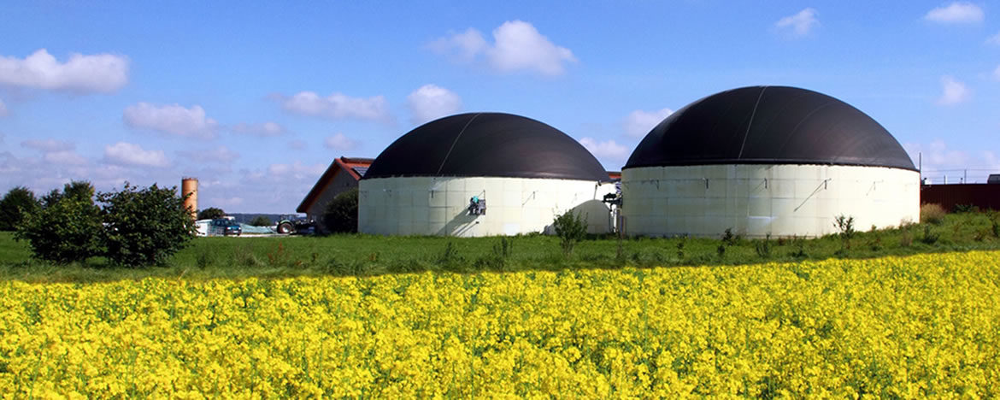
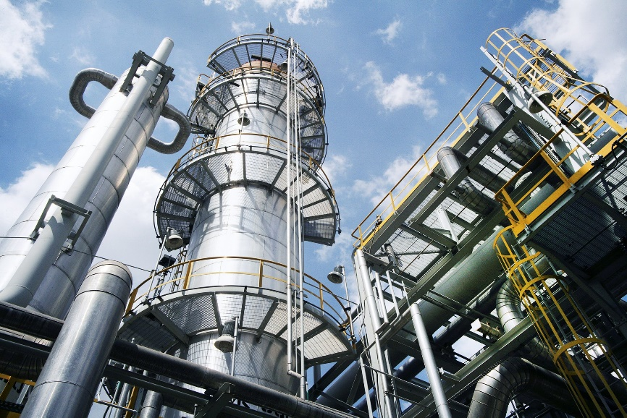
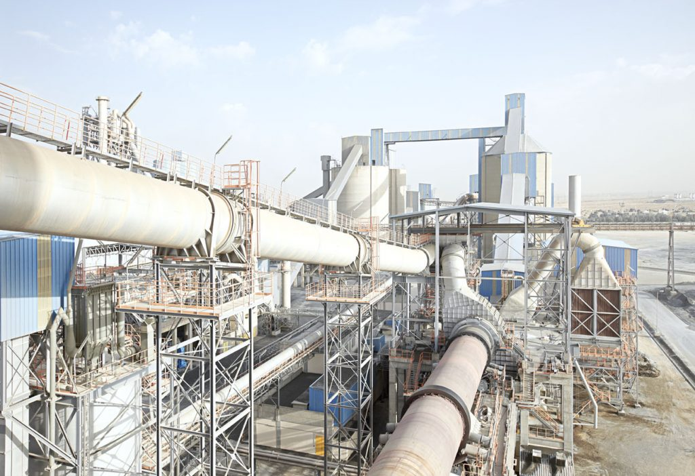
DTU focus
Biogas upgrading
Power industry (biomass combustion)
Cement production
Steel industry
Silicium production
Paper industry
Direct Air Capture (DAC)
Refining
Fermentation
Ethanol production
Ammonia Production
Aluminium production
Natural gas cleaning
Hydrogen production
Large navy industry
Combined SO₂ and CO₂ removal
Acid gas treatment

Slide 13
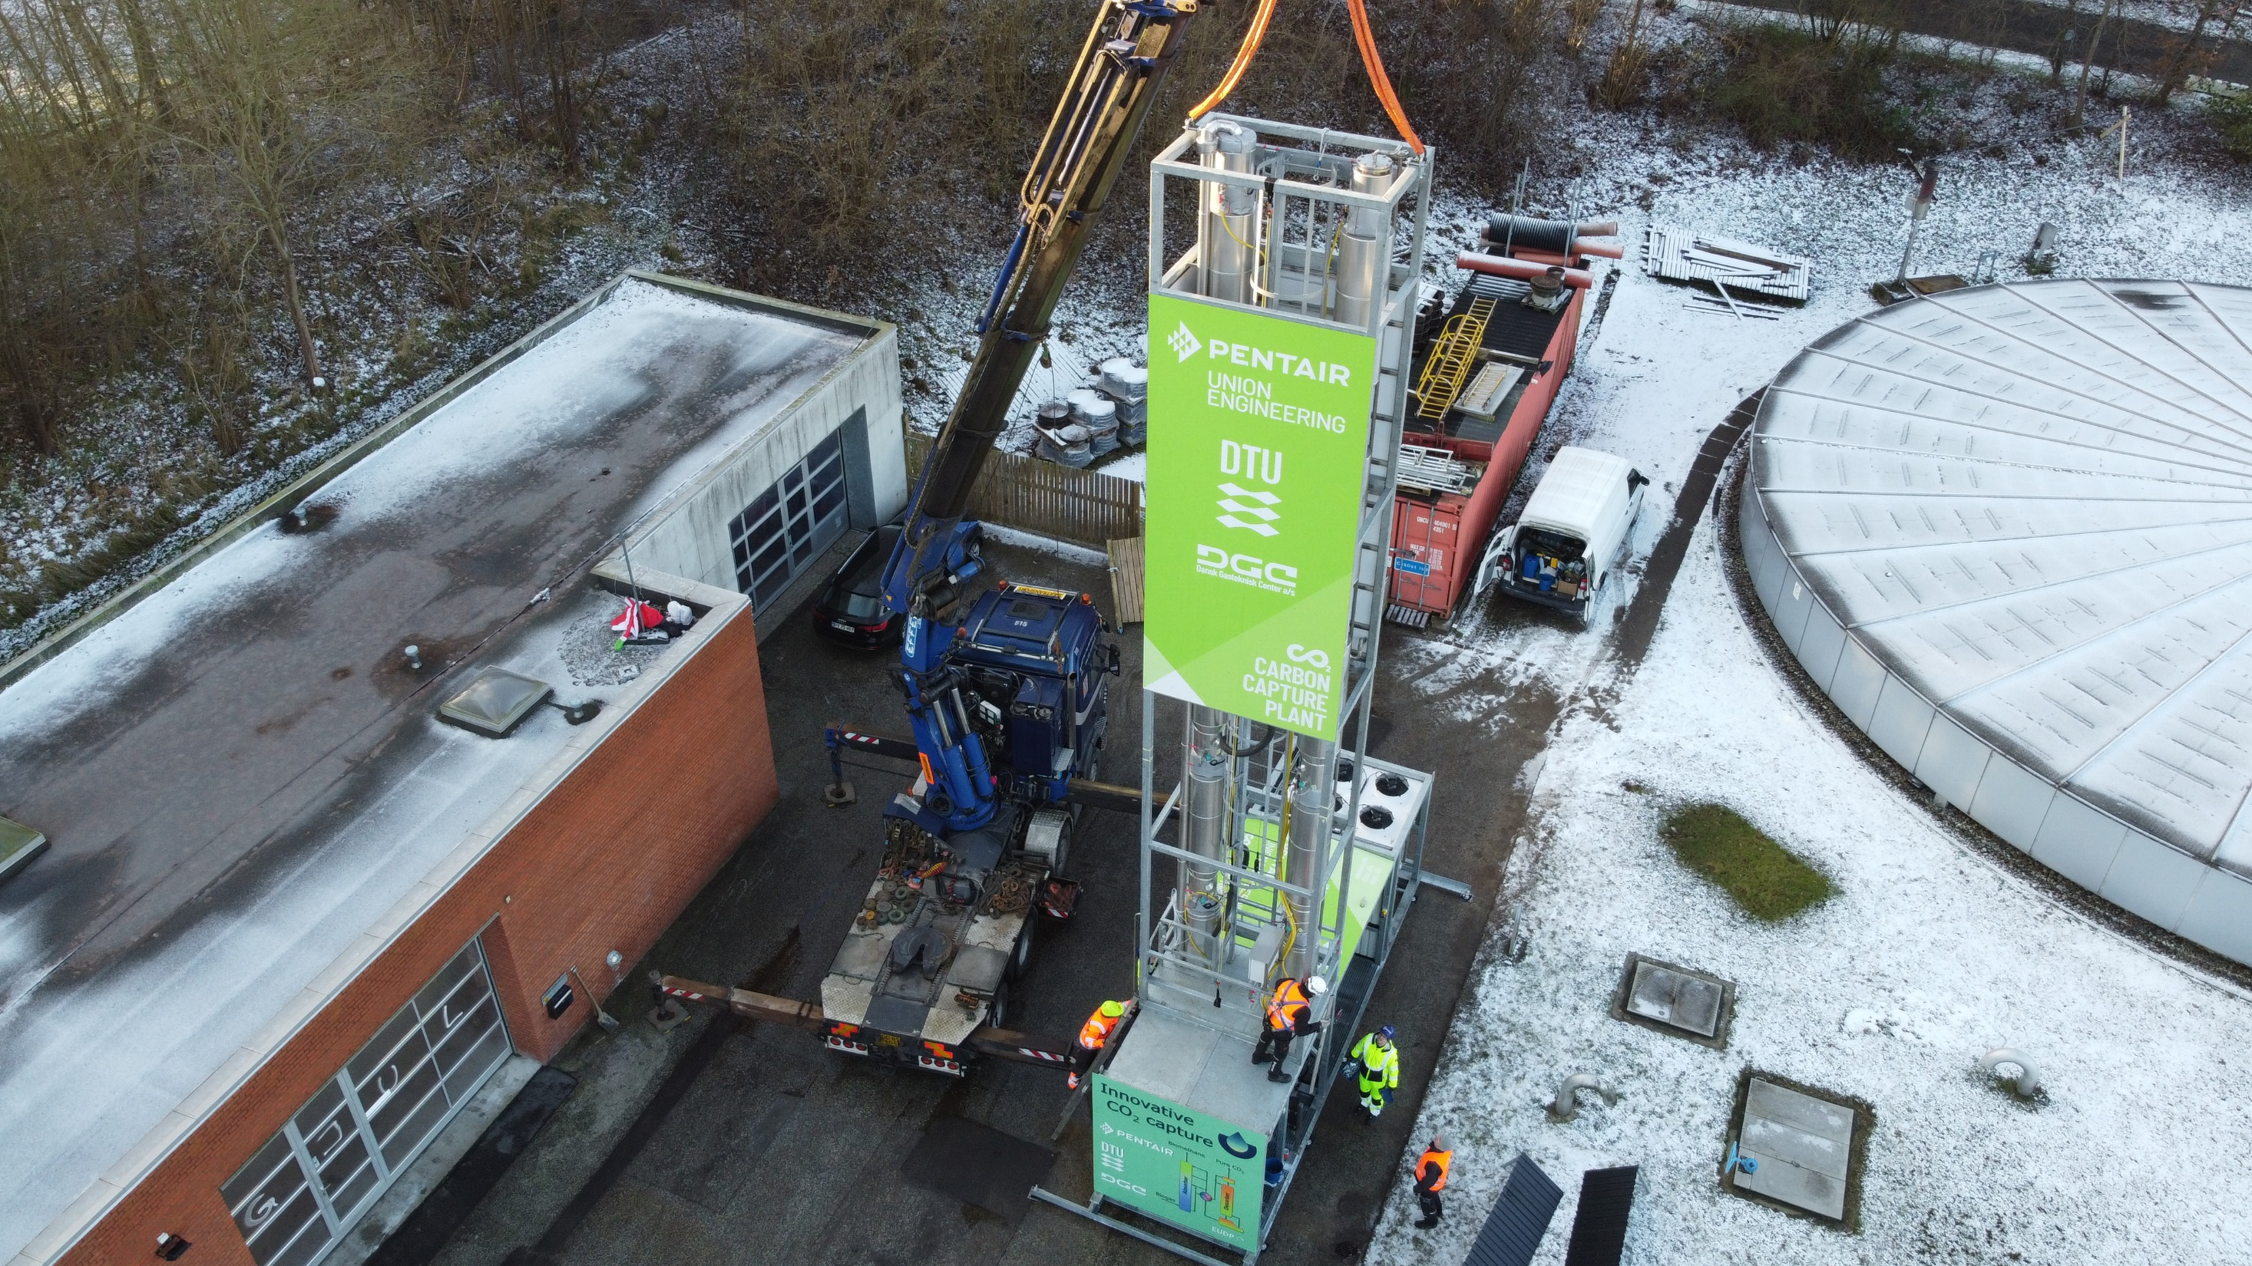
On-site capture testing, 1 ton/day

Slide 14
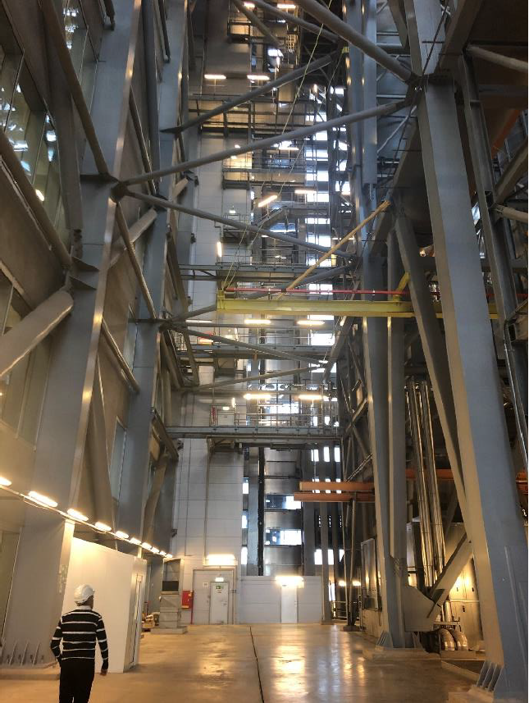
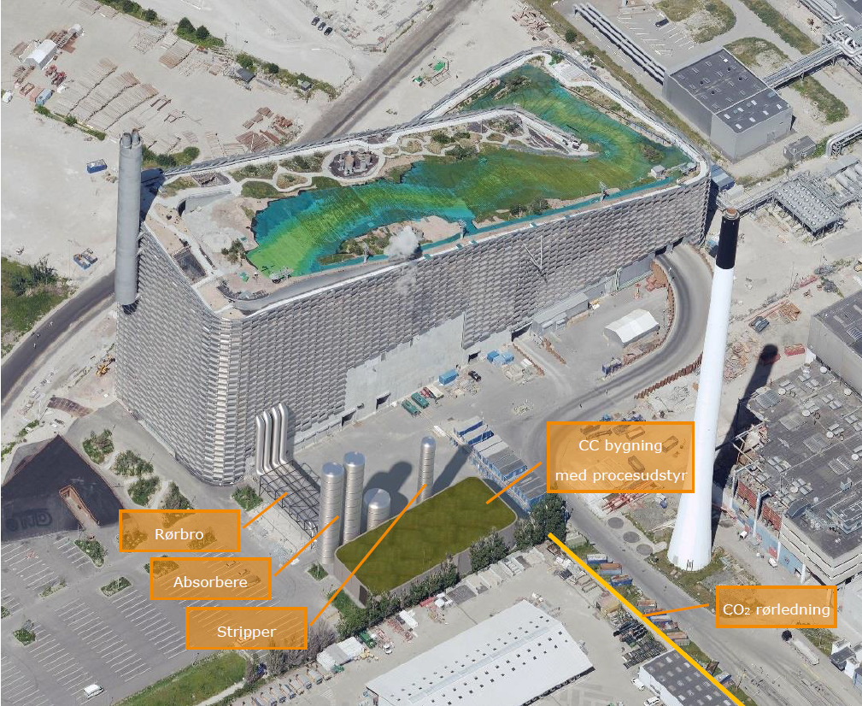
ARC: 62 mil DKK Net Zero Carbon Capture Eneergy consumption
Objectives
  Waste heat
  Heat integration
  Cost effectiveness
Pilot
Demonstration
Full scale design
  0.48 mtpa

Slide 15
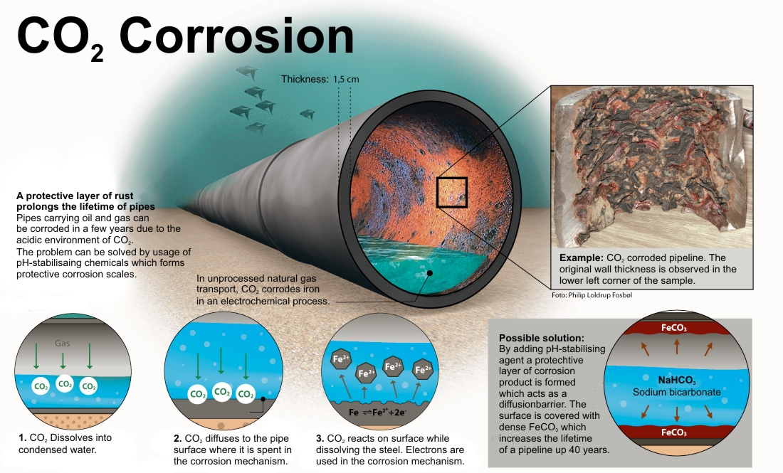

Slide 16
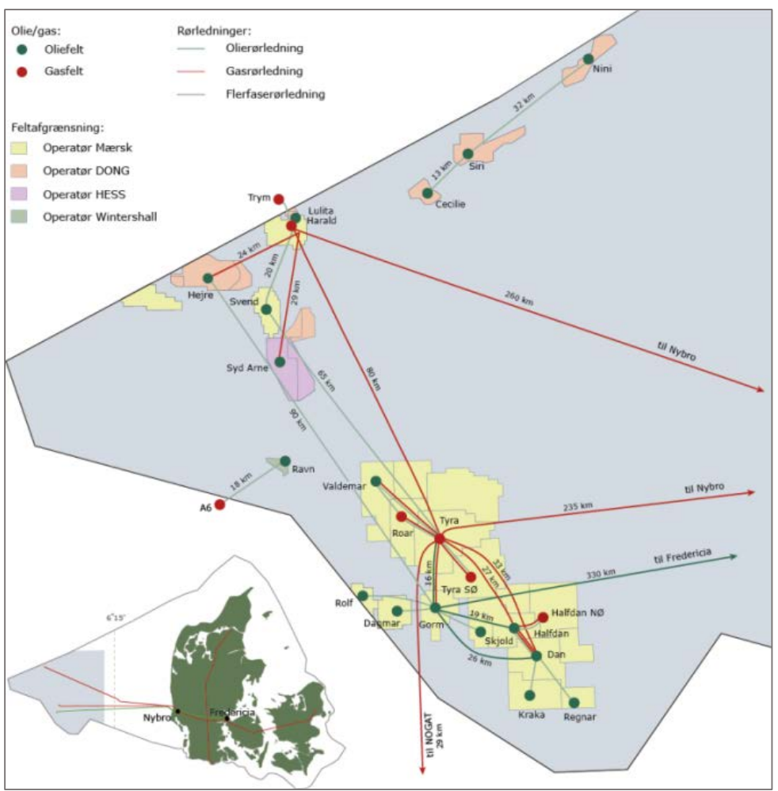
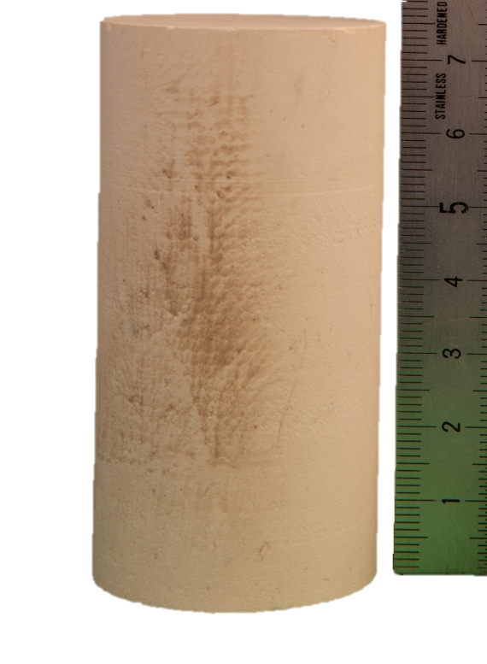

Total
Ineos
Chalk
Sandstone

Slide 17
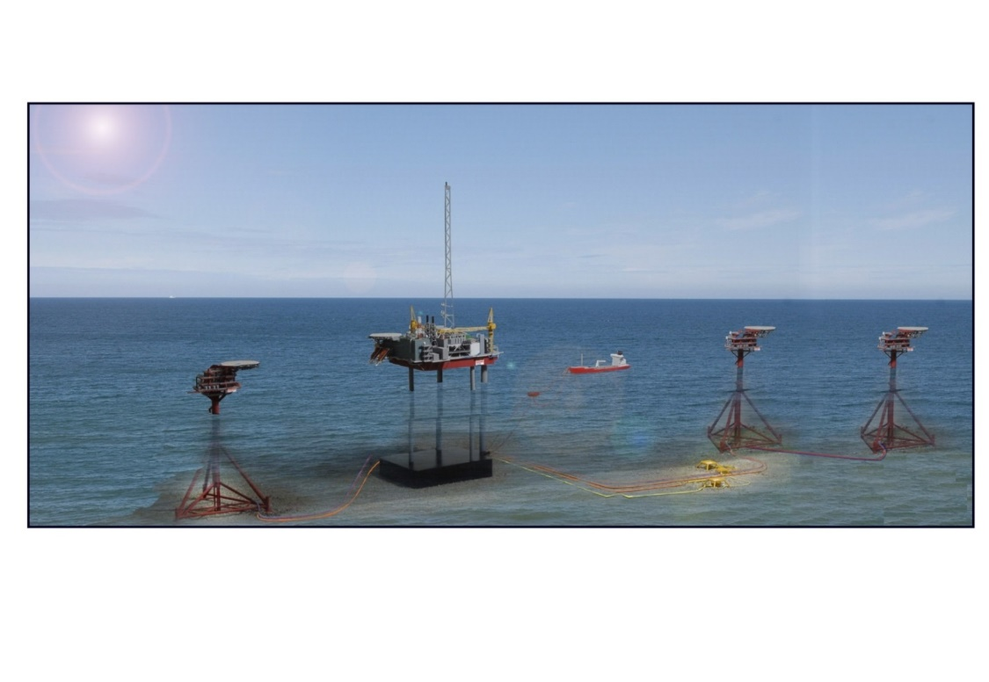
Siri Area storage Potentiale
Ineos prediction - Greensand
Siri area
Nini Field
CO₂-store | Statement of Feasibility | Pilot | CO₂ Ready | mta
Nini West | 2020 | 2022 | 2024 | 0,45
Nini Main | 2021 | Not required | 2024 | 1
Nini Ty | 2021 | 2022 | 2024 | 0,5
Cecilie Ty | 2021 | 2023 | 2025 | 0,5
Cecilie Aqu | 2022 | 2023 | 2027 | 1
Nini East | 2022 | Not required | 2027 | 1
Stine Seg 2 | 2022 | 2023 | 2025 | 2
Siri Main | 2023 | 2023 | 2028 | 3
Total |  |  |  | 9,5
Safety |  |  |  | 4,5
Greensand
Sandstone
Source: Ineos DK

Slide 18
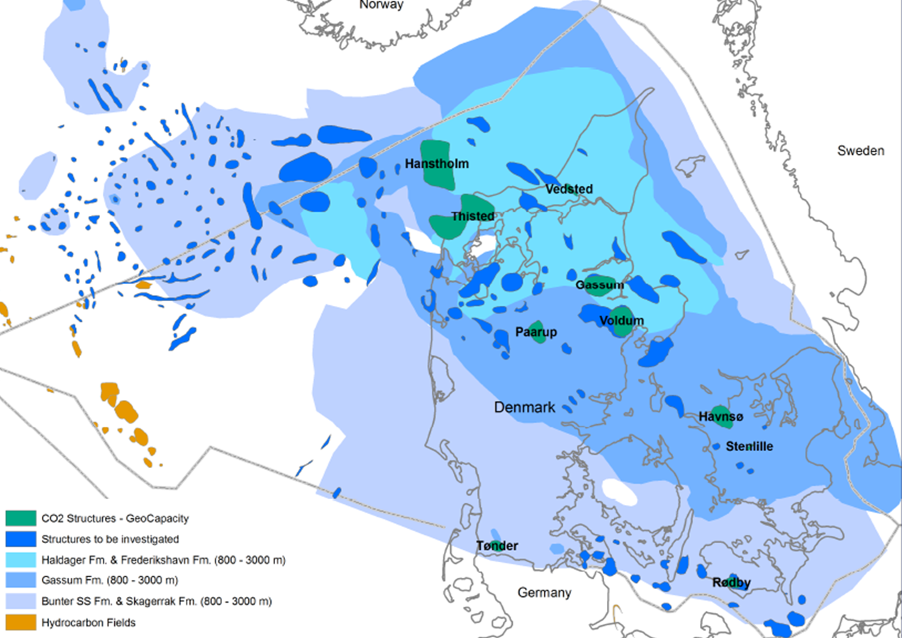
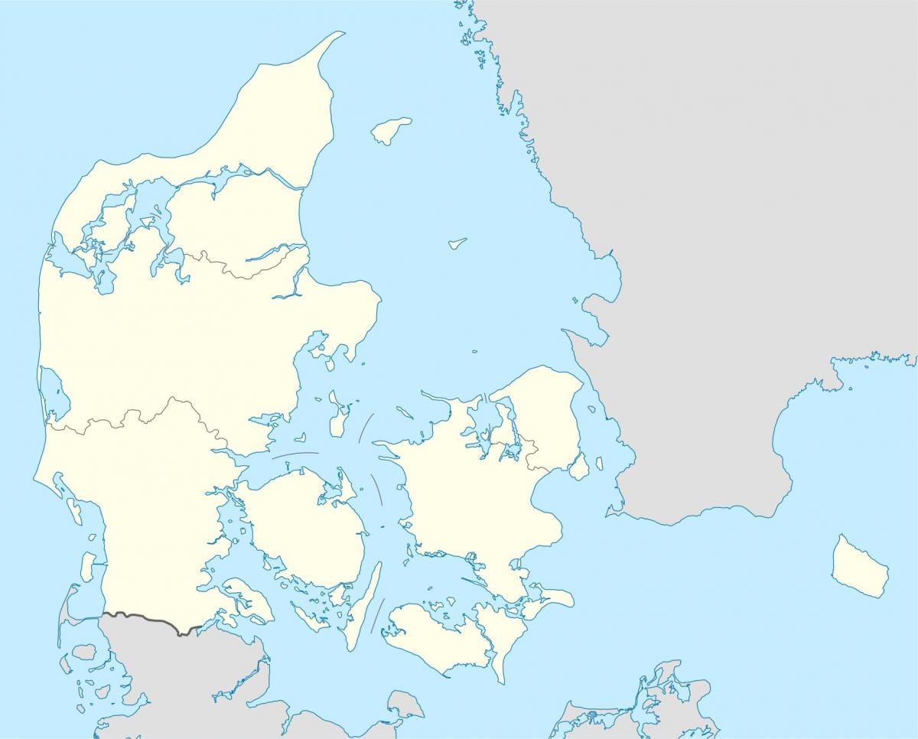
Larger point emitters
Source: GEUS
Aalborg portland
(2mtCO2)
Nordjylland
(383MW, 420MWt)
Approx 800 km
DK storage potential: 22.000 Mil. Ton
1000 years
Project GREENSAND
Herningværket
(95MWe, 174MWt)
Kundbyværket
(710MWe)
Approx 280 km
Vestforbrændingen
(0.6mta)
Amagerværket
(330MWe, 580MWt)
Skærbækværket
(392MWe, 447MWt)
Asnærværket
(147MWe, 100MWt)
ARC
(0.4mta)
KARA
(0.3mta)
Avedøreværket
(820MWe, 900MWt)
Esbjergværket
(378MWe, 420MWt)
Fynsværket
(362MWe, 475MWt
1.2mt)
Negative emission potential
Centralised : 11 mil. ton CO₂
Total: 18 mil. ton CO₂

Slide 19
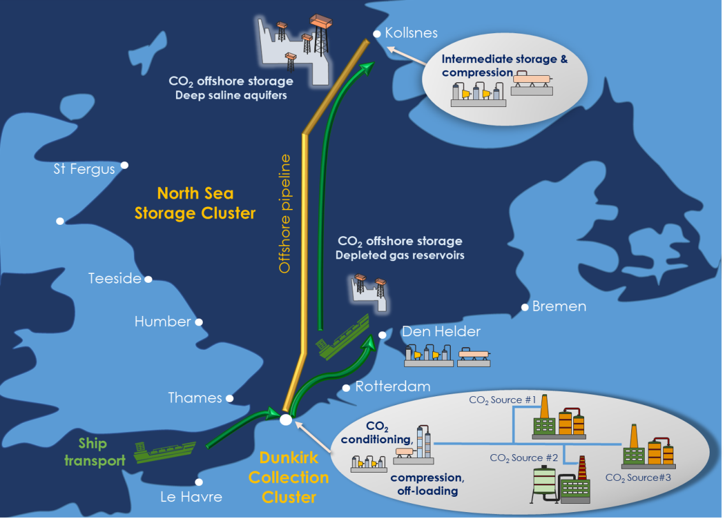
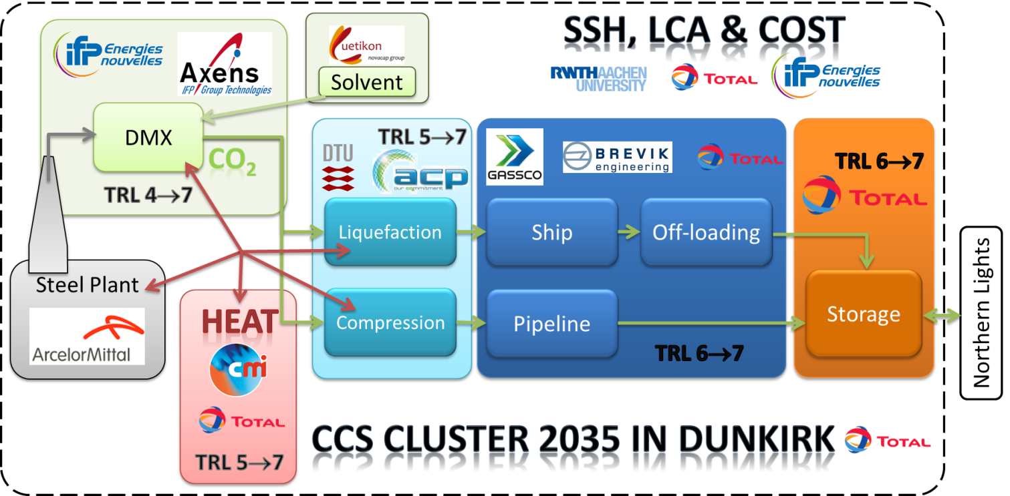
The 3D EU project
DTU objective: compression & liquefaction
19 mill EURO project

Slide 20
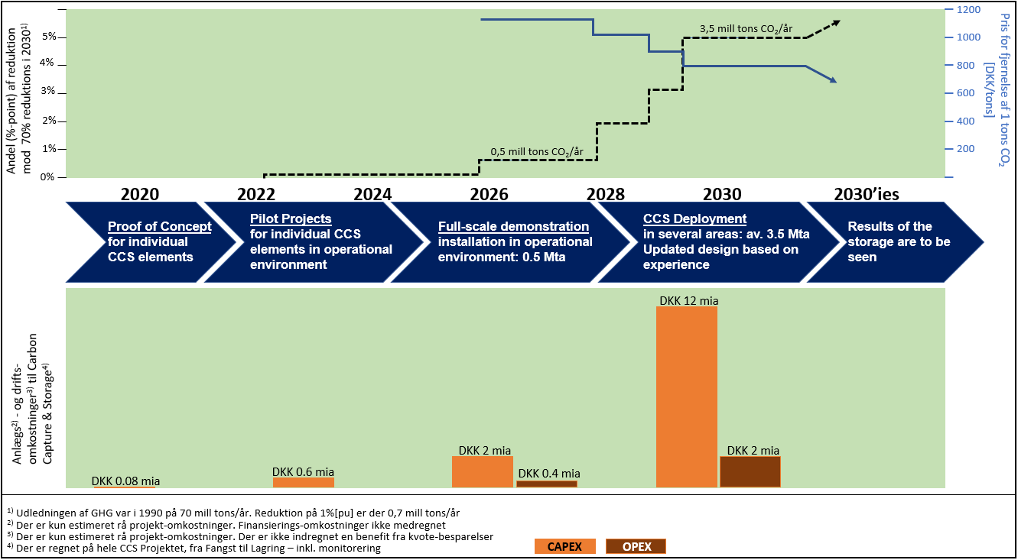
A DK CCS hub – time perspective
Source: Ineos DK

Slide 21
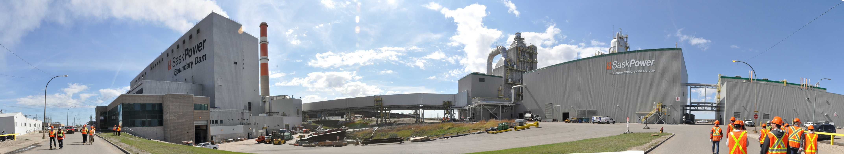
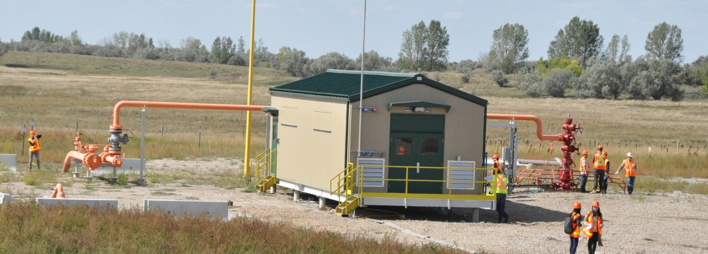
CCS, is it possible? Yes, Canada and Norway are doing it

Slide 22
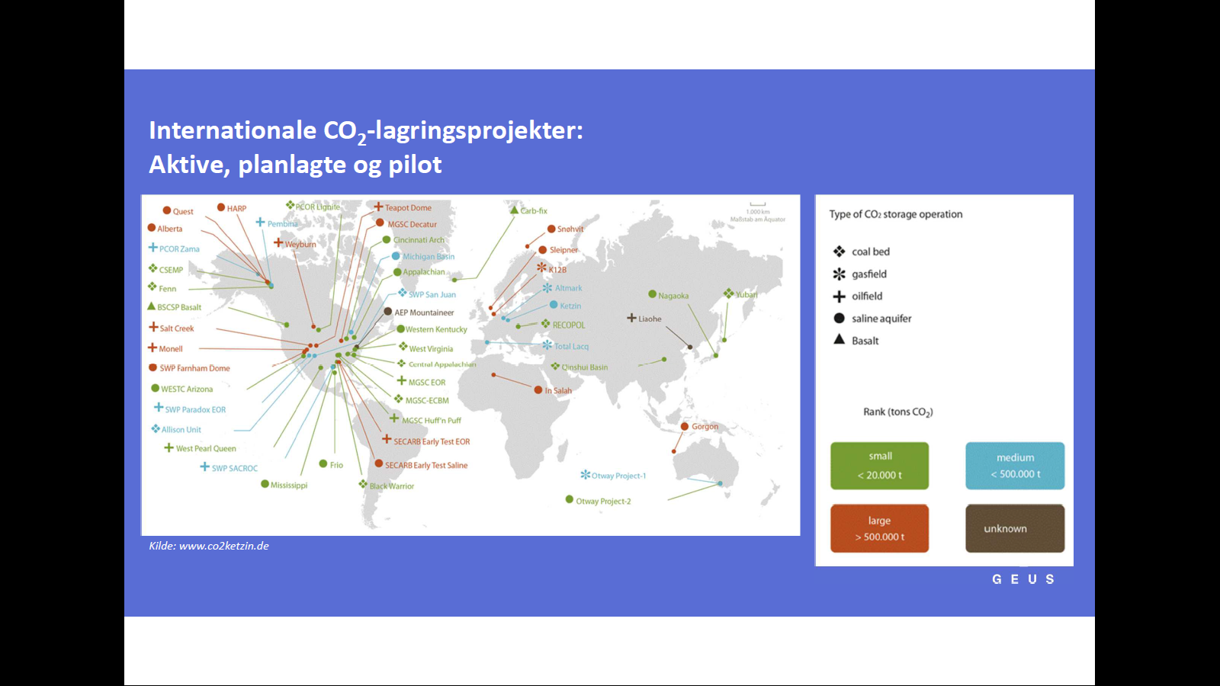
CCS – 1st generation exists

Slide 23

The Danish paradoxical CO₂ issues
DK guvernement focus 9 mta, possible: 4.5 mta, funding for 1 mta
Negative emission has no financial support
Offshore licenses do not allow permanent storage
Waste heat re-use is not feasible
Waste incineration plants: illegal CO₂ removal
No economic incentives to produce green cement or fuel
  Regulatory use
Missing CO₂ market pull/push
  No producers, no consumers, CO₂ hub
Power price too high
  Hydrogen price, grid/tax issue

Slide 24
Thank you

